Slide 1
Internet of Things: Data Collection and Analysis
October 22, 2023, 10:30
John L. Manferdelli
johnmanferdelli@hotmail.com

Slide 2
Data mining and analysis, part 1, probability
Data mining is grounded in probability and statistics, you should know:
What is probability? How is probability related to information?
The properties of probabilities
How to calculate probabilities
How to compute expectation and variance
How to compute covariance
What a probability distribution is especially important distributions like the Gaussian distribution and the Binomial distribution.
How to compute the information content of the output of a distribution.
The law of large numbers
How do we measure confidence

Slide 3
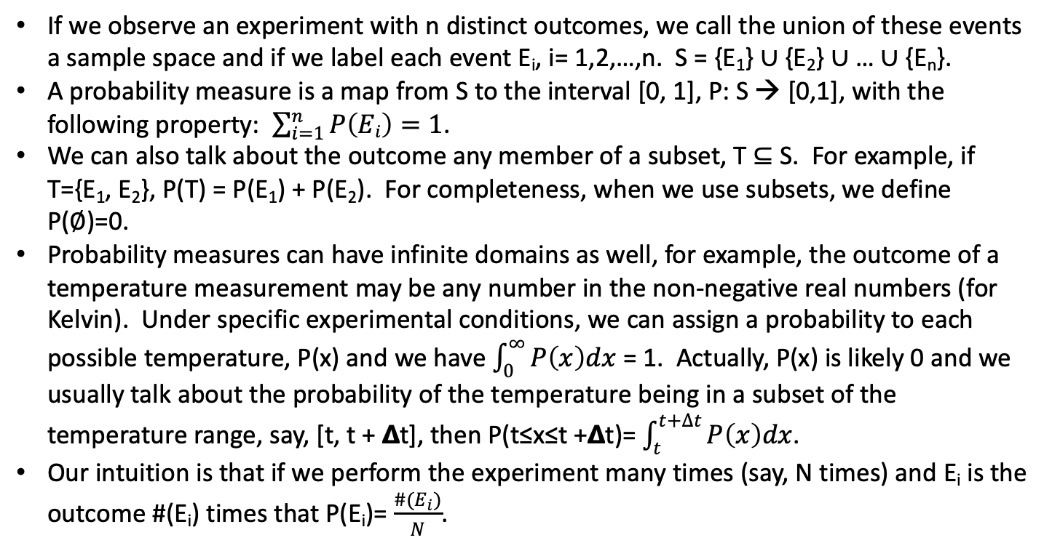
Probability
If we observe an experiment with n distinct outcomes, we call the union of these events a sample space and if we label each event E_{i}, i= 1,2,…,n. S = {E₁} ∪ {E₂} ∪ … ∪ {E_{n}}.
A probability measure is a map from S to the interval [0, 1], P: S → [0,1], with the following property: $\sum_{i=1}^{n}{P\left(Ei\right)=1}$.
We can also talk about the outcome any member of a subset, T ⊆ S. For example, if T={E₁, E₂}, P(T) = P(E₁) + P(E₂). For completeness, when we use subsets, we define P(∅)=0.
Probability measures can have infinite domains as well, for example, the outcome of a temperature measurement may be any number in the non-negative real numbers (for Kelvin). Under specific experimental conditions, we can assign a probability to each possible temperature, P(x) and we have $\int_{0}^{∞}{P\left(x\right)dx}$ = 1. Actually, P(x) is likely 0 and we usually talk about the probability of the temperature being in a subset of the temperature range, say, [t, t + 𝝙t], then P(t≤x≤t +𝝙t)= $\int_{t}^{t+∆t}{P\left(x\right)dx}$.
Our intuition is that if we perform the experiment many times (say, N times) and E_{i} is the outcome #(E_{i}) times that P(E_{i})= $\frac{\#(E_{i})}{N}$.

Slide 4
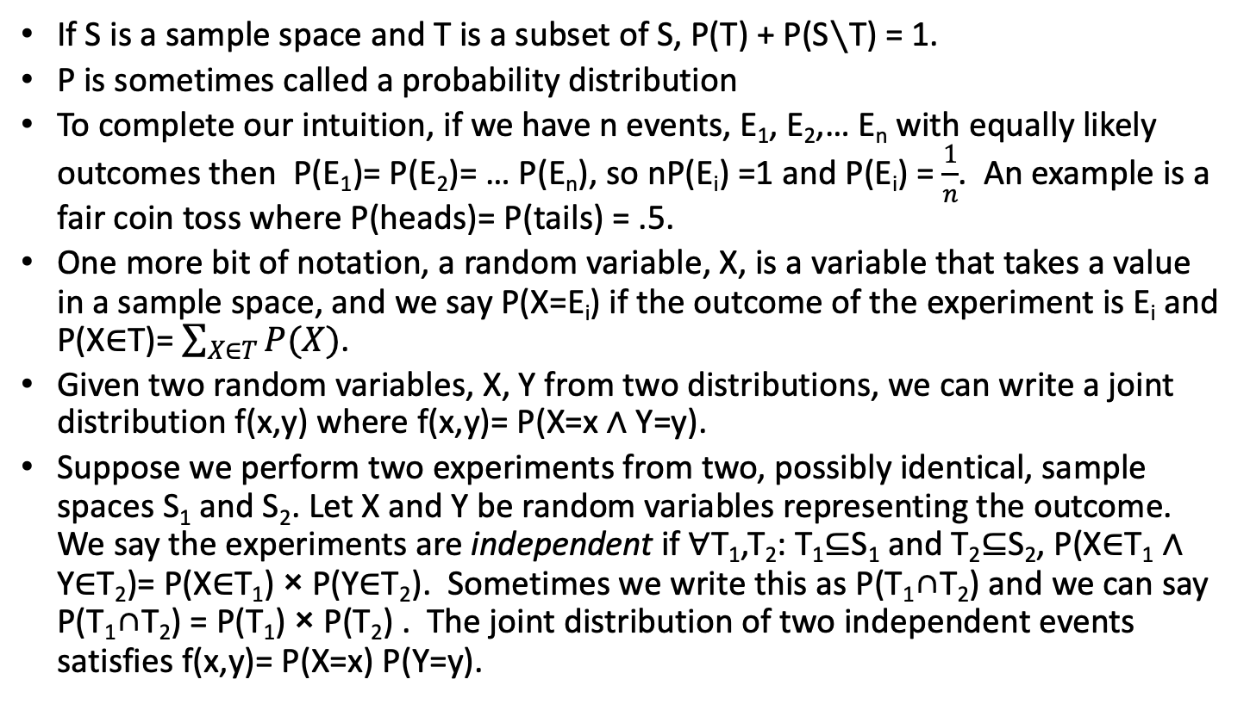
Probability
If S is a sample space and T is a subset of S, P(T) + P(S∖T) = 1.
P is sometimes called a probability distribution
To complete our intuition, if we have n events, E₁, E₂,… E_{n} with equally likely outcomes then P(E₁)= P(E₂)= … P(E_{n}), so nP(E_{i}) =1 and P(E_{i}) = $\frac{1}{n}$. An example is a fair coin toss where P(heads)= P(tails) = .5.
One more bit of notation, a random variable, X, is a variable that takes a value in a sample space, and we say P(X=E_{i}) if the outcome of the experiment is E_{i} and P(X∈T)= $\sum_{X∈T}{P(X)}$.
Given two random variables, X, Y from two distributions, we can write a joint distribution f(x,y) where f(x,y)= P(X=x ∧ Y=y).
Suppose we perform two experiments from two, possibly identical, sample spaces S₁ and S₂. Let X and Y be random variables representing the outcome. We say the experiments are independent if ∀T₁,T₂: T₁⊆S₁ and T₂⊆S₂, P(X∈T₁ ∧ Y∈T₂)= P(X∈T₁) × P(Y∈T₂). Sometimes we write this as P(T₁∩T₂) and we can say P(T₁∩T₂) = P(T₁) × P(T₂) . The joint distribution of two independent events satisfies f(x,y)= P(X=x) P(Y=y).

Slide 5
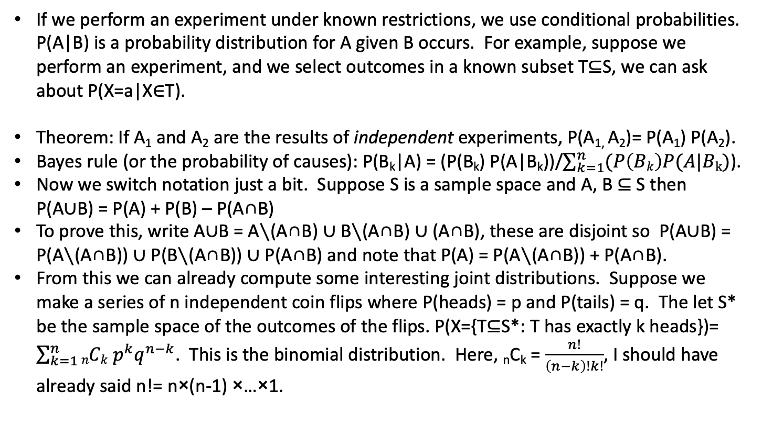
Conditional probability and counting
If we perform an experiment under known restrictions, we use conditional probabilities. P(A|B) is a probability distribution for A given B occurs. For example, suppose we perform an experiment, and we select outcomes in a known subset T⊆S, we can ask about P(X=a|X∈T).
Theorem: If A₁ and A₂ are the results of independent experiments, P(A_{1,} A₂)= P(A₁) P(A₂).
Bayes rule (or the probability of causes): P(B_{k}|A) = (P(B_{k}) P(A|B_{k}))/$\sum_{k=1}^{n}{(P\left(Bk\right)P(A|Bk)}$).
Now we switch notation just a bit. Suppose S is a sample space and A, B ⊆ S then P(A∪B) = P(A) + P(B) – P(A∩B)
To prove this, write A∪B = A∖(A∩B) ∪ B∖(A∩B) ∪ (A∩B), these are disjoint so P(A∪B) = P(A∖(A∩B)) ∪ P(B∖(A∩B)) ∪ P(A∩B) and note that P(A) = P(A∖(A∩B)) + P(A∩B).
From this we can already compute some interesting joint distributions. Suppose we make a series of n independent coin flips where P(heads) = p and P(tails) = q. The let S* be the sample space of the outcomes of the flips. P(X={T⊆S*: T has exactly k heads})= $\sum_{k=1}^{n}{nCk p^{k}q^{n−k}}$. This is the binomial distribution. Here, _{n}C_{k} = $\frac{n!}{\left(n−k\right)!k!}$, I should have already said n!= n×(n-1) ×…×1.

Slide 6
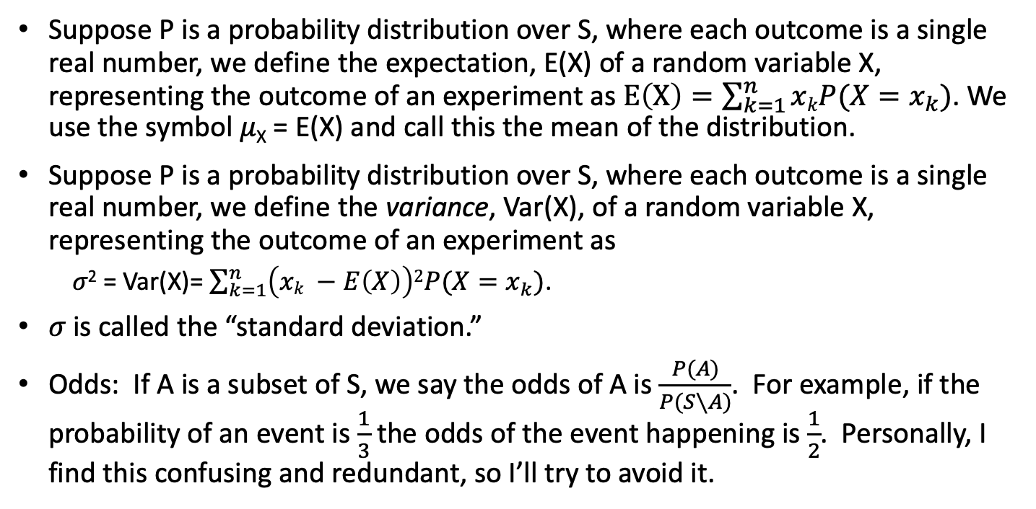
Expectation and variance
Suppose P is a probability distribution over S, where each outcome is a single real number, we define the expectation, E(X) of a random variable X, representing the outcome of an experiment as $E\left(X\right)=\sum_{k=1}^{n}{xkP(X=x_{k})}$. We use the symbol 𝜇_{X} = E(X) and call this the mean of the distribution.
Suppose P is a probability distribution over S, where each outcome is a single real number, we define the variance, Var(X), of a random variable X, representing the outcome of an experiment as
𝜎² = Var(X)= $\sum_{k=1}^{n}{\left(xk −E\left(X\right)\right)2P(X=x_{k})}$.
𝜎 is called the “standard deviation.”
Odds: If A is a subset of S, we say the odds of A is $\frac{P(A)}{P(S∖A)}$. For example, if the probability of an event is $\frac{1}{3}$the odds of the event happening is $\frac{1}{2}$. Personally, I find this confusing and redundant, so I’ll try to avoid it.

Slide 7
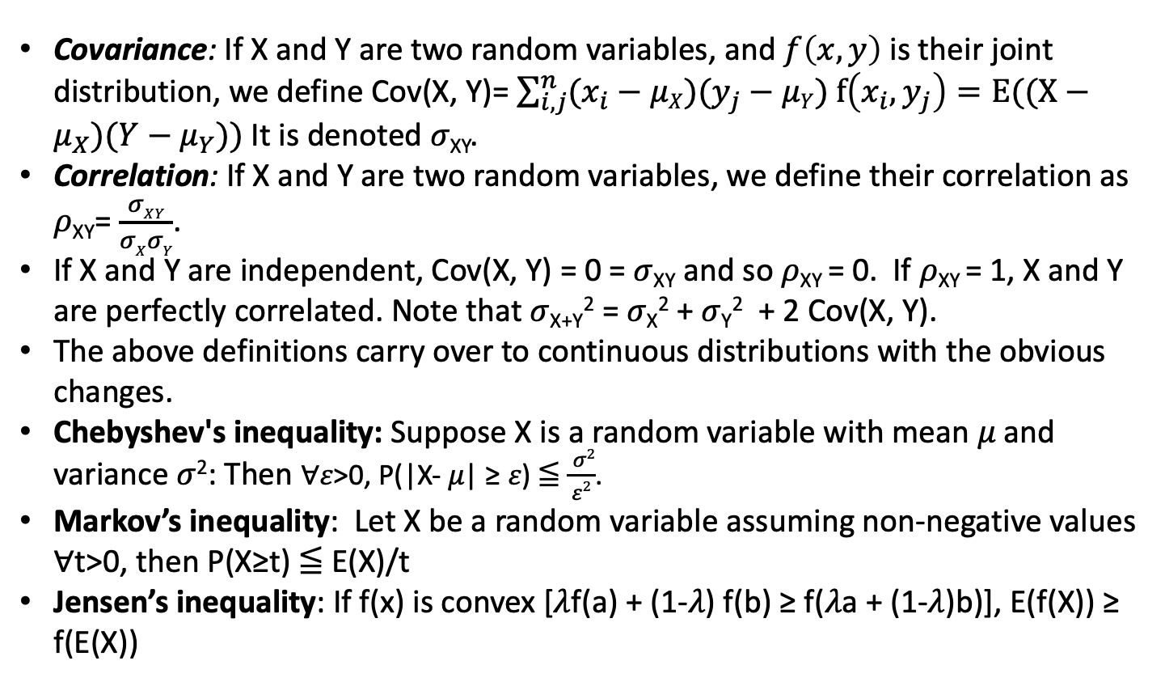
Covariance, correlation and inequalities
Covariance: If X and Y are two random variables, and $f\left(x,y\right)$ is their joint distribution, we define Cov(X, Y)= $\sum_{i,j}^{n}{(x_{i}−μX)(y_{j}−}$ $μY) f\left(x_{i},y_{j}\right)=E((X−μ_{X})(Y−μ_{Y}))$ It is denoted 𝜎_{XY}.
Correlation: If X and Y are two random variables, we define their correlation as 𝜌_{XY}= $\frac{σXY}{σXσY}$.
If X and Y are independent, Cov(X, Y) = 0 = 𝜎_{XY} and so 𝜌_{XY} = 0. If 𝜌_{XY} = 1, X and Y are perfectly correlated. Note that 𝜎_{X+Y}² = 𝜎_{X}² + 𝜎_{Y}² + 2 Cov(X, Y).
The above definitions carry over to continuous distributions with the obvious changes.
Chebyshev's inequality: Suppose X is a random variable with mean 𝜇 and variance 𝜎²: Then ∀𝜀>0, P(|X- 𝜇| ≥ 𝜀) ≦ $\frac{ σ2}{ε2}$.
Markov’s inequality: Let X be a random variable assuming non-negative values ∀t>0, then P(X≥t) ≦ E(X)/t
Jensen’s inequality: If f(x) is convex [𝜆f(a) + (1-𝜆) f(b) ≥ f(𝜆a + (1-𝜆)b)], E(f(X)) ≥ f(E(X))

Slide 8
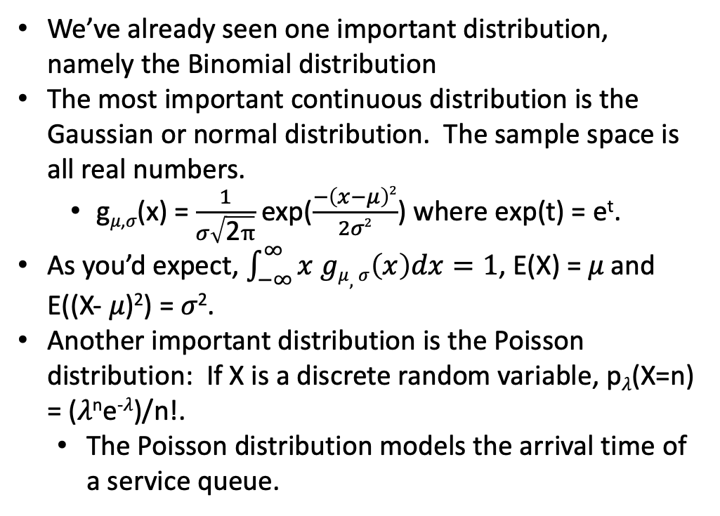
Distributions
We’ve already seen one important distribution, namely the Binomial distribution
The most important continuous distribution is the Gaussian or normal distribution. The sample space is all real numbers.
g_{𝜇,𝜎}(x) = $\frac{1}{σ\sqrt{\text{2}π}}$ exp($\frac{−\left(x−μ\right)2}{2σ2}$) where exp(t) = e^{t}.
As you’d expect, $\int_{−∞}^{∞}{x gμ,σ\left(x\right)dx=1}$, E(X) = 𝜇 and E((X- 𝜇)²) = 𝜎².
Another important distribution is the Poisson distribution: If X is a discrete random variable, p_{𝜆}(X=n) = (𝜆^{n}e^{-𝜆})/n!.
The Poisson distribution models the arrival time of a service queue.
Normal distribution, Wikipedia
Poisson distribution, Wikipedia

Slide 9
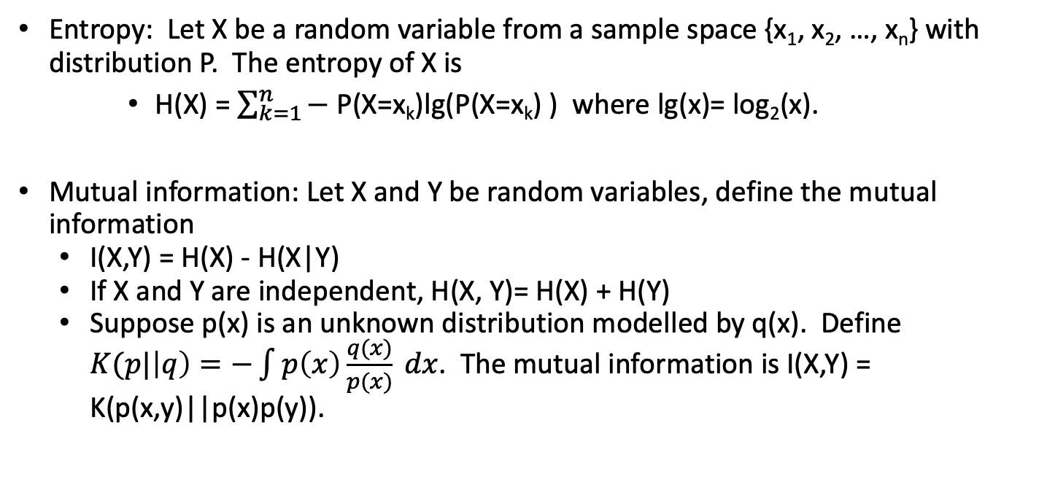
Information
Entropy: Let X be a random variable from a sample space {x₁, x₂, …, x_{n}} with distribution P. The entropy of X is
H(X) = $\sum_{k=1}^{n}{−}$ P(X=x_{k})lg(P(X=x_{k}) ) where lg(x)= log₂(x).
Mutual information: Let X and Y be random variables, define the mutual information
I(X,Y) = H(X) - H(X|Y)
If X and Y are independent, H(X, Y)= H(X) + H(Y)
Suppose p(x) is an unknown distribution modelled by q(x). Define $K(p|\left|q\right)=−\int{p\left(x\right)\frac{q(x)}{p(x)} dx}$. The mutual information is I(X,Y) = K(p(x,y)||p(x)p(y)).

Slide 10
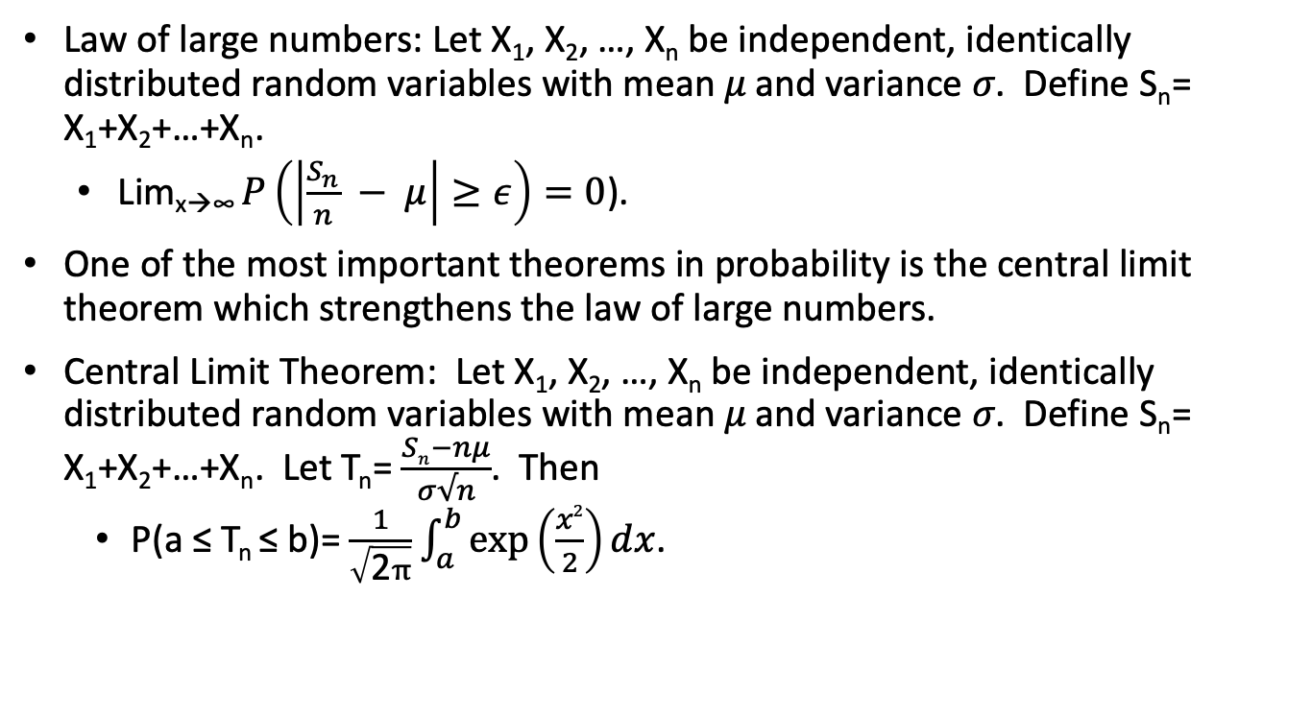
Long term behavior
Law of large numbers: Let X₁, X₂, …, X_{n} be independent, identically distributed random variables with mean 𝜇 and variance 𝜎. Define S_{n}= X₁+X₂+…+X_{n}.
Lim_{x→∞} $P\left(\left|\frac{S_{n}}{n} − μ\right|≥ε\right)=0$).
One of the most important theorems in probability is the central limit theorem which strengthens the law of large numbers.
Central Limit Theorem: Let X₁, X₂, …, X_{n} be independent, identically distributed random variables with mean 𝜇 and variance 𝜎. Define S_{n}= X₁+X₂+…+X_{n}. Let T_{n}= $\frac{Sn−nμ}{σ√n}$. Then
P(a ≤ T_{n} ≤ b)= $\frac{1}{\sqrt{\text{2}π}}$ $\int_{a}^{b}{\exp\left(\frac{x2}{2}\right)dx}$.

Slide 11
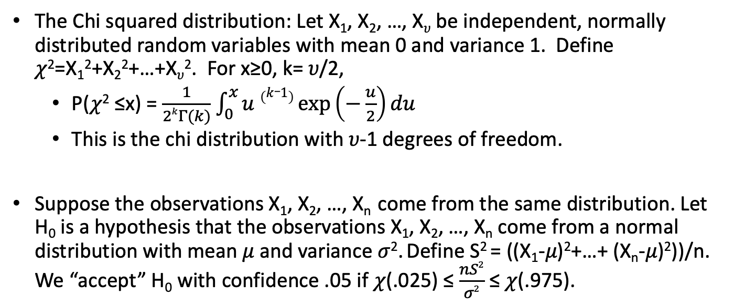
Confidence and significance
The Chi squared distribution: Let X₁, X₂, …, X_{𝜐} be independent, normally distributed random variables with mean 0 and variance 1. Define 𝜒²=X₁²+X₂²+…+X_{𝜐}². For x≥0, k= 𝜐/2,
P(𝜒² ≤x) = $\frac{1}{2kΓ(k)}$ $\int_{0}^{x}{u \left(k_1\right)\exp\left(−\frac{u}{2}\right)du}$
This is the chi distribution with 𝜐-1 degrees of freedom.
Suppose the observations X₁, X₂, …, X_{n} come from the same distribution. Let H₀ is a hypothesis that the observations X₁, X₂, …, X_{n} come from a normal distribution with mean 𝜇 and variance 𝜎². Define S² = ((X₁-𝜇)²+…+ (X_{n}-𝜇)²))/n. We “accept” H₀ with confidence .05 if 𝜒(.025) ≤ $\frac{nS2}{σ2}$ ≤ 𝜒(.975).

Slide 12
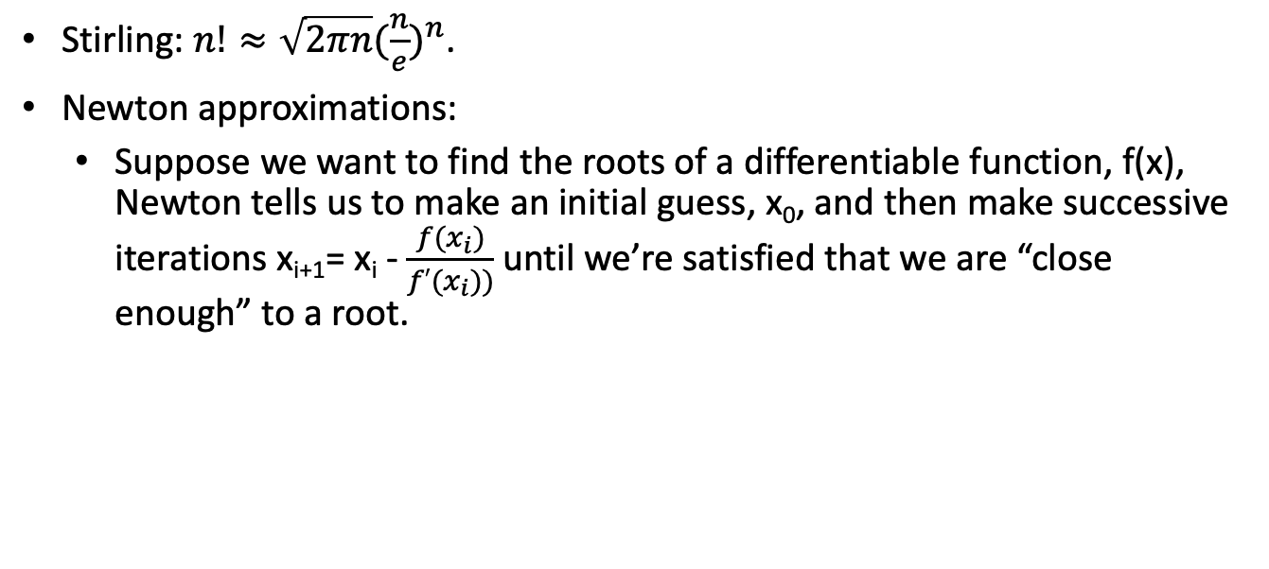
Useful facts
Stirling: $n!≈\sqrt{2πn}{(\frac{n}{e})}^{n}$.
Newton approximations:
Suppose we want to find the roots of a differentiable function, f(x), Newton tells us to make an initial guess, x₀, and then make successive iterations x_{i+1}= x_{i} - $\frac{f(x_{i})}{f′(x_{i}))}$ until we’re satisfied that we are “close enough” to a root.

Slide 13
Data mining and analysis, part 2
The art of curve fitting
Model for machine learning
Supervised and unsupervised learning
Features and collection
Similarity and clustering
Feature cosine
K-means clustering

Slide 14
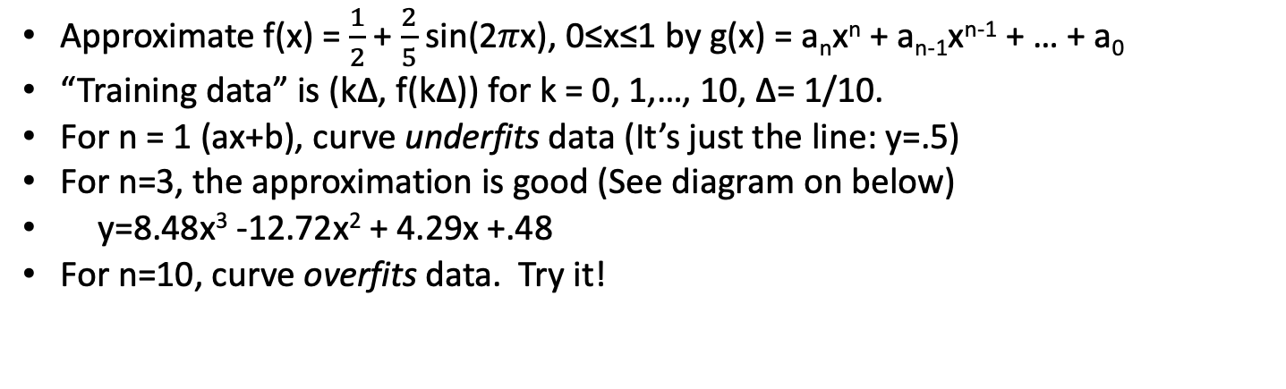
Curve fitting
Approximate f(x) = $\frac{1}{2}$ + $\frac{2}{5}$ sin(2𝜋x), 0≤x≤1 by g(x) = a_{n}x^{n} + a_{n-1}x^{n-1} + … + a₀
“Training data” is (k∆, f(k∆)) for k = 0, 1,…, 10, ∆= 1/10.
For n = 1 (ax+b), curve underfits data (It’s just the line: y=.5)
For n=3, the approximation is good (See diagram on below)
y=8.48x³ -12.72x² + 4.29x +.48
For n=10, curve overfits data. Try it!

Slide 15
What are we trying to learn?
Often, we seek to use data to predict or detect behavior, characteristics or actions that are not directly observable from data.
There are two common classes of machine learning tasks.
Regression: Predict a continuous variable (say, the selling price of a house) based on data that is available prior to sale with some assurance.
Classification: Determine which of a finite number of classes some process indicates. For example, whether an email is spam based on the text of the mail or determining whether a story is deceptive propaganda based on the way the story is written.
In both cases, we’re trying to learn the parameters (say, 𝜇 and 𝜎) of an unknown distribution or discriminating whether an experimental sample comes from a distribution with parameters (𝜇₁, 𝜎₁) or parameters (𝜇₂, 𝜎₂).

Slide 16
How do we learn - 1
First, we need to decide what data should be collected; we call each element of the data a feature.
For text, the features might be the presence or frequency of particular words.
For predicting the sale price of a house, the features might be total square footage, the past average selling price of houses in the neighborhood or the name (or traffic density) of facing or surrounding streets.
Features can be real numbers, boolean values, or non-numeric characteristic (selected from a finite set, like color).
Feature selection is one of the most important tasks in machine learning. Too many features can make practical collection impossible, mask characteristics, or lead to computationally impossible task for learning or operation (The curse of dimensionality”).

Slide 17
How do we learn - 2
There are two kinds of learning:
Supervised learning
Here, we have examples of features and the corresponding, labeled, ground truth about the desired outcome. More precisely, we have a data set (x(k), y(k)), k = 1, 2,…, m where x(k) is a vector of feature data, one feature datum per vector coordinate. y(k) is a labelled outcome, that is, if we were asked to predict or classify based on x(k), we should say y(k). (x(k), y(k)), k = 1, 2,…, m is the training data.
Unsupervised learning
Does not have access to ground truth labelled data learning and prediction are continuous.
K-means clustering is an unsupervised technique.
For supervised learning:
In the learning phase, we “learn” a function of the features, based on the training data, which makes the prediction in which we are interested.
Sometimes training data is divided into “training” and “test” data. We train on the training data and use the test data to see how well we do.
In the operational phase, we use the self-same features in new data instances to predict the outcome.

Slide 18
Collection, provenance and features
There are important practical questions in collection, learning and prediction.
How reliable is the data we’re using to learn from (where did we get it)?
Has someone introduced deceptive training data to adversely affect the learning.
How do we collect it?
How do we store and organize it?
How big is it?
What features should we focus on?

Slide 19
Let’s begin
We’ll start with three simple techniques we use constantly
Similarity measurement
Clustering
Visualization

Slide 20
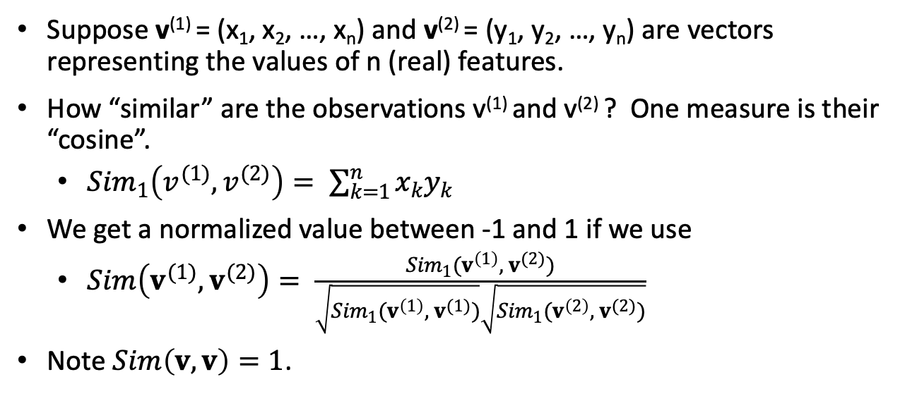
Similarity
Suppose v⁽¹⁾ = (x₁, x₂, …, x_{n}) and v⁽²⁾ = (y₁, y₂, …, y_{n}) are vectors representing the values of n (real) features.
How “similar” are the observations v⁽¹⁾ and v⁽²⁾ ? One measure is their “cosine”.
${Sim}_{1}\left(v^{(1)},v^{(2)}\right)= \sum_{k=1}^{n}{x_{k}y_{k}}$
We get a normalized value between -1 and 1 if we use
$Sim\left(v^{(1)},v^{(2)}\right)= \frac{{Sim}_{1}(v^{\left(1\right)}, { v}^{(2)})}{\sqrt{{Sim}_{1}(v^{\left(1\right)}, { v}^{(1)})}\sqrt{{Sim}_{1}(v^{\left(2\right)}, { v}^{(2)})}}$
Note $Sim\left(v, v\right)=1$.

Slide 21
Clustering
A very simple and efficient way to take n observations in a real vector space of dimension p and distribute them into k clusters uses the “k-means” algorithm.
In a cluster, each element of the cluster is closer to the cluster mean than the mean of another cluster.
Here is the the k-means algorithm for the observations x₁, x₂, …, x_{m}.
Let the k-cluster centers be y₁, y₂,…, y_{k}.
Initialization
Pick k of the original m points at random (the first k are fine) and assign them as cluster centers
Assign each each of the original points to a cluster based on the closest cluster center (old_cluster_assignment)
loop
Compute a new cluster centers y₁’, y₂’,,…, y_{k}’ based on old_cluster_assignment to clusters
Assign each original point to a cluster based on the new cluster (new_cluster_assignment)
If old_cluster_assignment is the same as new_cluster_assignment return y₁, y₂,…, y_{k}.
old_cluster_assignment ← new_cluster_assignment and y₁, y₂,,…, y_{k} ← y₁’, y₂’,,…, y_{k}’
loop
This converges quickly.

Slide 22
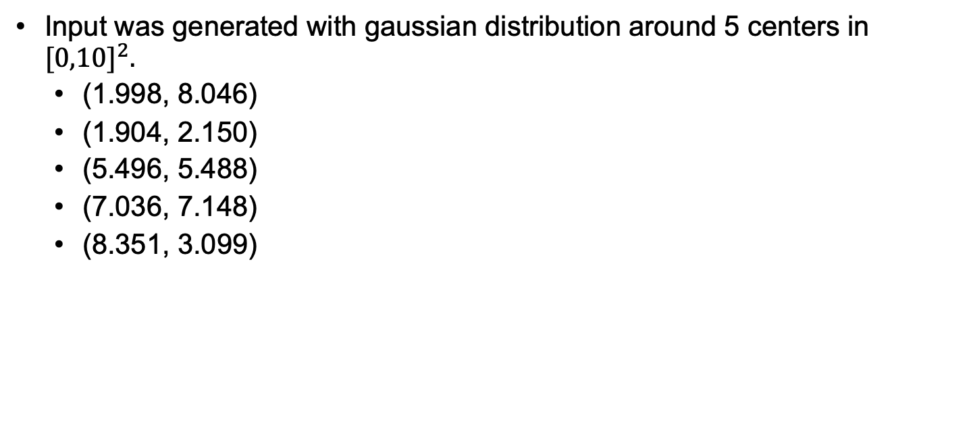
Clustering example
Input was generated with gaussian distribution around 5 centers in ${[0,10]}^{2}.$
(1.998, 8.046)
(1.904, 2.150)
(5.496, 5.488)
(7.036, 7.148)
(8.351, 3.099)
X
X
X
X
X

Slide 23
Visualization
Often, just plotting the data, or some derived version of the data is instructive.
Among the most common graphing and plotting methods are:
Mathlab
Excel
Python graphing package like this and this.
My daughter is an artist and could say a lot more.
Not me.

Slide 24
Data mining and analysis, part 3, regression
Regression and learning
Least squares
Gradient descent
Examples
Overfitting, underfitting and regularization
Training and validation: training set and test set

Slide 25
Regression: learning functions
The regression problem is to learn a function to predict the outcome of experiments based on observable features of a process (like words in a text).
We will develop three types of regression learning:
Linear regression
Logistic regression
Deep learning (later)

Slide 26
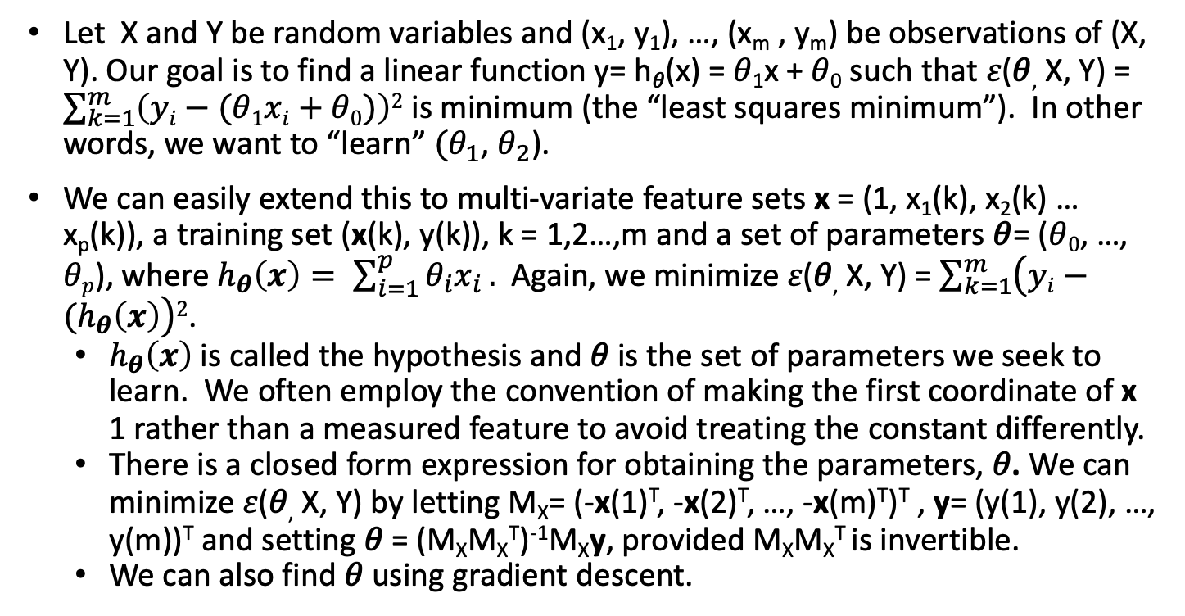
Linear regression - least squares
Let X and Y be random variables and (x₁, y₁), …, (x_{m} , y_{m}) be observations of (X, Y). Our goal is to find a linear function y= h_{𝜃}(x) = 𝜃₁x + 𝜃₀ such that 𝜀(𝜃, X, Y) = $\sum_{k=1}^{m}{\left(yi−(\text{θ}1xi+\text{θ}0)\right)2}$ is minimum (the “least squares minimum”). In other words, we want to “learn” $(θ_{1}$, $θ_{2}$).
We can easily extend this to multi-variate feature sets x = (1, x₁(k), x₂(k) … x_{p}(k)), a training set (x(k), y(k)), k = 1,2…,m and a set of parameters $\text{θ}$= ($\text{θ}0$, …, $\text{θ}p$), where $h_{θ}\left(x\right)= \sum_{i=1}^{p}{θ_{i}x_{i}}.$ Again, we minimize 𝜀(𝜃, X, Y) = $\sum_{k=1}^{m}{\left(yi−(h_{θ}\left(x\right)\right)2}$.
$h_{θ}\left(x\right)$is called the hypothesis and 𝜃 is the set of parameters we seek to learn. We often employ the convention of making the first coordinate of x 1 rather than a measured feature to avoid treating the constant differently.
There is a closed form expression for obtaining the parameters, 𝜃. We can minimize 𝜀(𝜃, X, Y) by letting M_{X}= (-x(1)^{T}, -x(2)^{T}, …, -x(m)^{T})^{T} , y= (y(1), y(2), …, y(m))^{T} and setting 𝜃 = (M_{X}M_{X}^{T})⁻¹M_{X}y, provided M_{X}M_{X}^{T} is invertible.
We can also find 𝜃 using gradient descent.

Slide 27
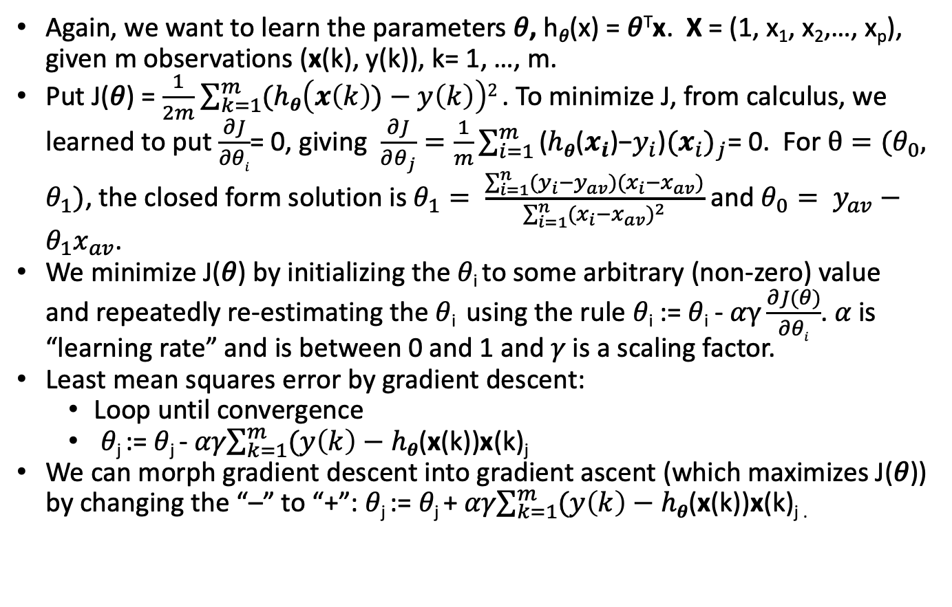
Gradient descent
Again, we want to learn the parameters 𝜃, h_{𝜃}(x) = 𝜃^{T}x. X = (1, x₁, x₂,…, x_{p}), given m observations (x(k), y(k)), k= 1, …, m.
Put J(𝜃) = $\frac{1}{2m}$ $\sum_{k=1}^{m}{(hθ\left(x\left(k\right))−y\left(k\right)\right)2}$. To minimize J, from calculus, we learned to put $\frac{∂J}{∂θi}$= 0, giving $\frac{∂J}{∂θ_{j}}=\frac{1}{m}\sum_{i=1}^{m}{\text{(}hθ\text{(}x_{i}\text{)−}y_{i}\text{)}{(x_{i})}_{j}}$= 0. For $θ=(θ_{0}, θ_{1})$, the closed form solution is $θ_{1}= \frac{\sum_{i=1}^{n}{(y_{i}−y_{av})(x_{i}−x_{av})}}{\sum_{i=1}^{n}{{(x_{i}−x_{av})}^{2}}}$ and $θ_{0}= y_{av}−θ_{1}x_{av}$.
We minimize J(𝜃) by initializing the 𝜃_{i} to some arbitrary (non-zero) value and repeatedly re-estimating the 𝜃_{i} using the rule 𝜃_{i} := 𝜃_{i} - 𝛼$γ\frac{∂J(θ)}{∂θi}$. 𝛼 is “learning rate” and is between 0 and 1 and 𝛾 is a scaling factor.
Least mean squares error by gradient descent:
Loop until convergence
𝜃_{j} := 𝜃_{j} - 𝛼𝛾$\sum_{k=1}^{m}{(y\left(k\right)−hθ}$(x(k))x(k)_{j}
We can morph gradient descent into gradient ascent (which maximizes J(𝜃)) by changing the “–” to “+”: 𝜃_{j} := 𝜃_{j} + 𝛼𝛾$\sum_{k=1}^{m}{(y\left(k\right)−hθ}$(x(k))x(k)_{j .}

Slide 28
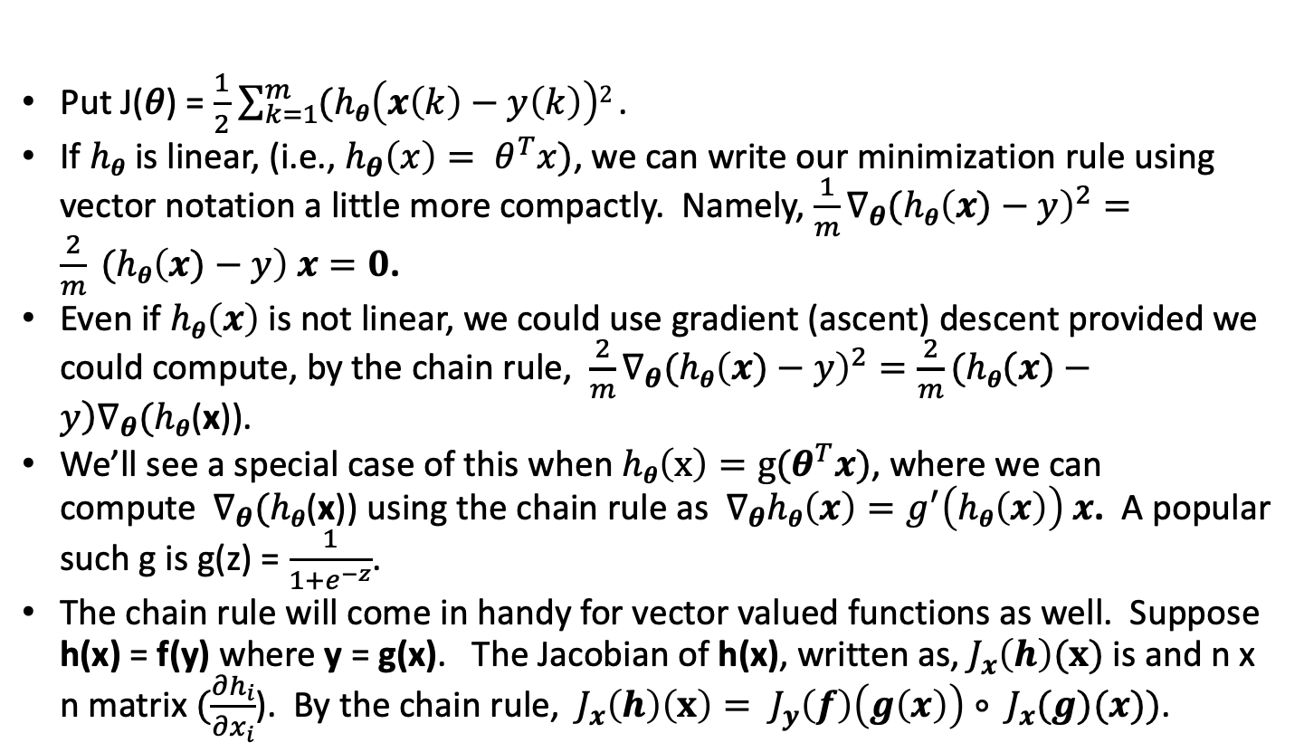
Gradient descent for non-linear functions
Put J(𝜃) = $\frac{1}{2}$ $\sum_{k=1}^{m}{(hθ\left(x\left(k\right)−y\left(k\right)\right)2}$.
If $hθ$ is linear, (i.e., $h_{θ}\left(x\right)= θ^{T}x)$, we can write our minimization rule using vector notation a little more compactly. Namely, ${{\frac{1}{m}∇}_{θ}(hθ\left(x)−y\right)}^{2}=\frac{2}{m} (hθ\left(x)−y\right) x=0$.
Even if $hθ\left(x\right)$ is not linear, we could use gradient (ascent) descent provided we could compute, by the chain rule, ${{\frac{2}{m}∇}_{θ}(hθ\left(x)−y\right)}^{2}={\frac{2}{m}(hθ\left(x)−y\right)∇}_{θ}(hθ$(x)).
We’ll see a special case of this when $hθ\left(x\right)=g(θ^{T}x)$, where we can compute${ ∇}_{θ}(hθ$(x)) using the chain rule as${ ∇}_{θ}hθ\left(x\right)=g^{′}\left(hθ\left(x\right)\right) x$. A popular such g is g(z) = $\frac{1}{1+e^{−z}}$.
The chain rule will come in handy for vector valued functions as well. Suppose h(x) = f(y) where y = g(x). The Jacobian of h(x), written as, $J_{x}\left(h\right)(x)$ is and n x n matrix $(\frac{∂h_{i}}{∂x_{i}}$). By the chain rule, $J_{x}\left(h\right)\left(x\right)= J_{y}\left(f\right)\left(g\left(x\right)\right)∘ J_{x}(g)(x))$.

Slide 29
Gradient descent vs closed form
Learning rate
If we pick 𝜶 too large, oscillations may be large, and the process might not even converge.
If we pick 𝜶 too small convergence is slow.
Gradient descent
Is iterative
Can be adapted to complex hypothesis
Works well when m is large
Supports incremental learning
Converges to local optimum (OK for quadratic functions.)
Close form solution
Works well when m is small
No need to select learning rate

Slide 30
Ng’s example¹: learning housing prices
size bdrms price
2104 3 399900
1600 3 329900
2400 3 369000
1416 2 232000
3000 4 539900
1985 4 299900
1534 3 314900
1427 3 198999
1380 3 212000
1494 3 242500
1940 4 239999
2000 3 347000
1890 3 329999
4478 5 699900
size bdrms price
1268 3 259900
2300 4 449900
1320 2 299900
1236 3 199900
2609 4 499998
3031 4 599000
1767 3 252900
1888 2 255000
1604 3 242900
1962 4 259900
3890 3 573900
1100 3 249900
1458 3 464500
2526 3 469000
size bdrms price
2200 3 475000
2637 3 299900
1839 2 349900
1000 1 169900
2040 4 314900
3137 3 579900
1811 4 285900
1437 3 249900
1239 3 229900
2132 4 345000
4215 4 549000
2162 4 287000
1664 2 368500
2238 3 329900
size bdrms price
2567 4 314000
1200 3 299000
852 2 179900
1852 4 299900
1203 3 239500
Direct solution
b: 92392.92, w: (139.30948, -9681.65919)
Prediction: 1500 square ft, 3 bedrooms, predicted price: 272312.16, rms: 9325.08
Gradient descent
num_steps: 78
b: 78680.71678, w: (128.67889, 2461.29430)
Prediction: 1500 square ft, 3 bedrooms, predicted price: 279082.93, rms: 11891.09
¹ From Andrew Ng’s Stanford class notes

Slide 31
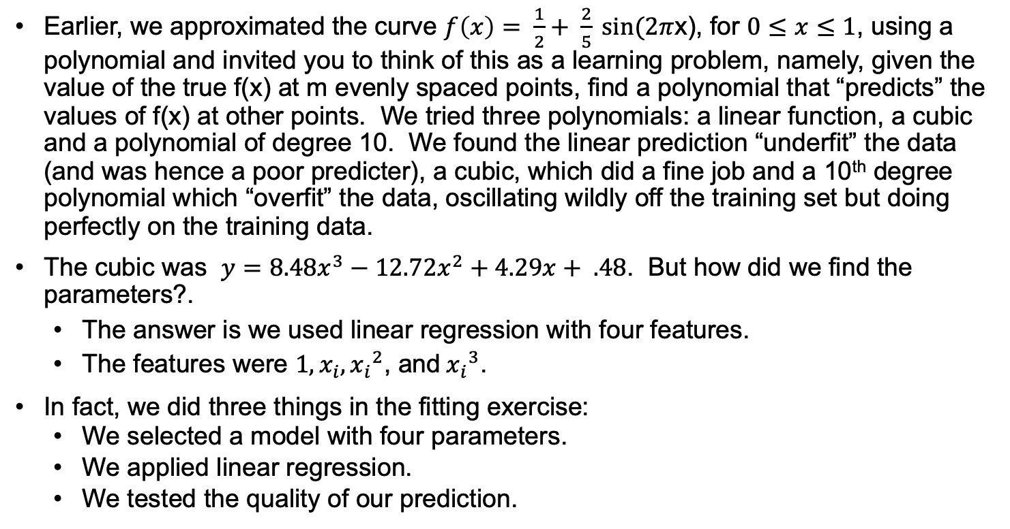
Overfitting and underfitting revisited
Earlier, we approximated the curve $f\left(x\right)= \frac{1}{2}+ \frac{2}{5} sin⁡(2π$x), for $0≤x≤1$, using a polynomial and invited you to think of this as a learning problem, namely, given the value of the true f(x) at m evenly spaced points, find a polynomial that “predicts” the values of f(x) at other points. We tried three polynomials: a linear function, a cubic and a polynomial of degree 10. We found the linear prediction “underfit” the data (and was hence a poor predicter), a cubic, which did a fine job and a 10th degree polynomial which “overfit” the data, oscillating wildly off the training set but doing perfectly on the training data.
The cubic was $y=8.48x^{3}−12.72x^{2}+4.29x+ .48$. But how did we find the parameters?.
The answer is we used linear regression with four features.
The features were ${1,x}_{i}, {x_{i}}^{2}$, and${{ x}_{i}}^{3}$.
In fact, we did three things in the fitting exercise:
We selected a model with four parameters.
We applied linear regression.
We tested the quality of our prediction.
Motivation for this slide is from Bishop, Pattern Recognition and Machine Learning

Slide 32
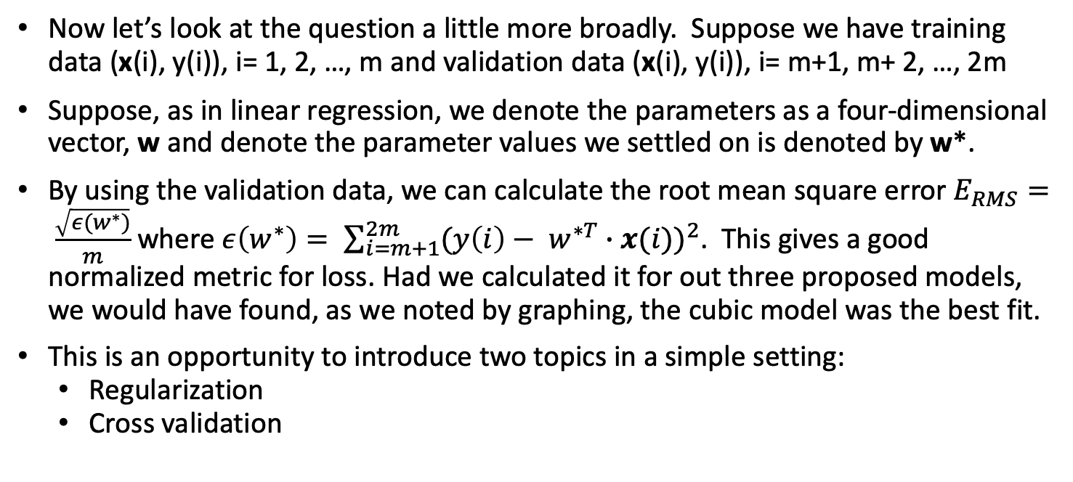
Overfitting and underfitting revisited
Now let’s look at the question a little more broadly. Suppose we have training data (x(i), y(i)), i= 1, 2, …, m and validation data (x(i), y(i)), i= m+1, m+ 2, …, 2m
Suppose, as in linear regression, we denote the parameters as a four-dimensional vector, w and denote the parameter values we settled on is denoted by w*.
By using the validation data, we can calculate the root mean square error $E_{RMS}= \frac{\sqrt{ε(w^{∗})}}{m}$ where $ε\left(w^{∗}\right)= \sum_{i=m+1}^{2m}{{(y\left(i\right)− w^{∗T}∙x(i))}^{2}}$. This gives a good normalized metric for loss. Had we calculated it for out three proposed models, we would have found, as we noted by graphing, the cubic model was the best fit.
This is an opportunity to introduce two topics in a simple setting:
Regularization
Cross validation
Motivation for this slide is from Bishop, Pattern Recognition and Machine Learning

Slide 33
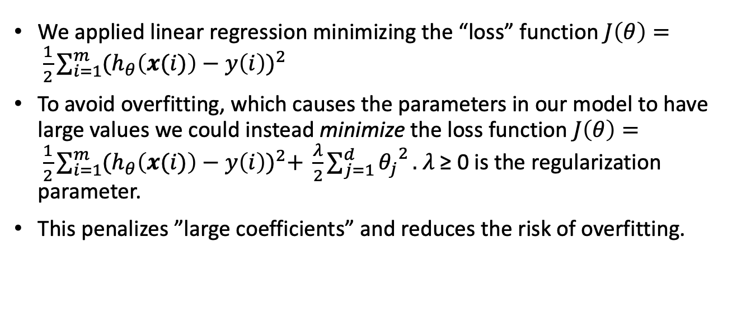
Regularization
We applied linear regression minimizing the “loss” function $J\left(θ\right)= \frac{1}{2}\sum_{i=1}^{m}{{(h_{θ}\left(x(i)\right)−y\left(i\right))}^{2}}$
To avoid overfitting, which causes the parameters in our model to have large values we could instead minimize the loss function $J\left(θ\right)= \frac{1}{2}\sum_{i=1}^{m}{{(h_{θ}\left(x(i)\right)−y\left(i\right))}^{2}+ \frac{λ}{2}\sum_{j=1}^{d}{{θ_{j}}^{2}}}.$ 𝜆 ≥ 0 is the regularization parameter.
This penalizes ”large coefficients” and reduces the risk of overfitting.
Motivation for this slide is from Bishop, Pattern Recognition and Machine Learning

Slide 34
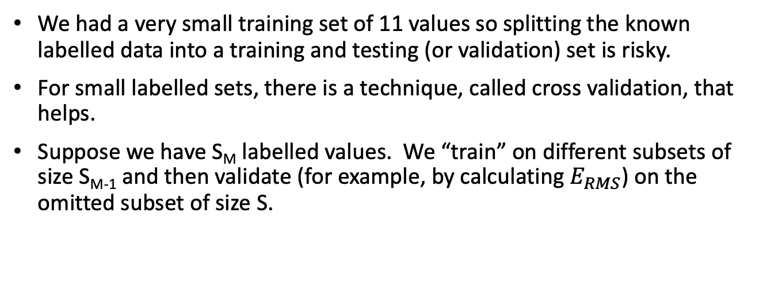
Cross validation
We had a very small training set of 11 values so splitting the known labelled data into a training and testing (or validation) set is risky.
For small labelled sets, there is a technique, called cross validation, that helps.
Suppose we have S_{M} labelled values. We “train” on different subsets of size S_{M-1} and then validate (for example, by calculating $E_{RMS}$) on the omitted subset of size S.
Motivation for this slide is from Bishop, Pattern Recognition and Machine Learning

Slide 35
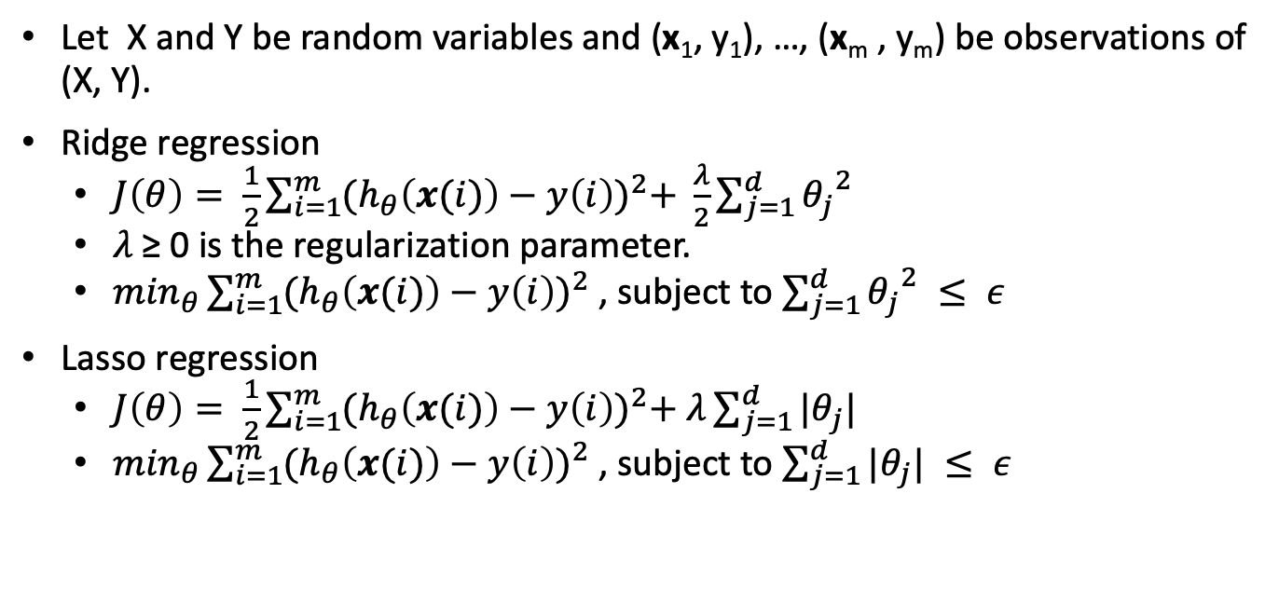
Regularizing regression
Let X and Y be random variables and (x₁, y₁), …, (x_{m} , y_{m}) be observations of (X, Y).
Ridge regression
$J\left(θ\right)= \frac{1}{2}\sum_{i=1}^{m}{{(h_{θ}\left(x(i)\right)−y\left(i\right))}^{2}+ \frac{λ}{2}\sum_{j=1}^{d}{{θ_{j}}^{2}}}$
𝜆 ≥ 0 is the regularization parameter.
$\min_{θ}\sum_{i=1}^{m}{{(h_{θ}\left(x(i)\right)−y\left(i\right))}^{2} }$, subject to $\sum_{j=1}^{d}{{θ_{j}}^{2} ≤ ε}$
Lasso regression
$J\left(θ\right)= \frac{1}{2}\sum_{i=1}^{m}{{(h_{θ}\left(x(i)\right)−y\left(i\right))}^{2}+ λ\sum_{j=1}^{d}{|θ_{j}|}}$
$\min_{θ}\sum_{i=1}^{m}{{(h_{θ}\left(x(i)\right)−y\left(i\right))}^{2} }$, subject to $\sum_{j=1}^{d}{|θ_{j}|} ≤ ε$

Slide 36
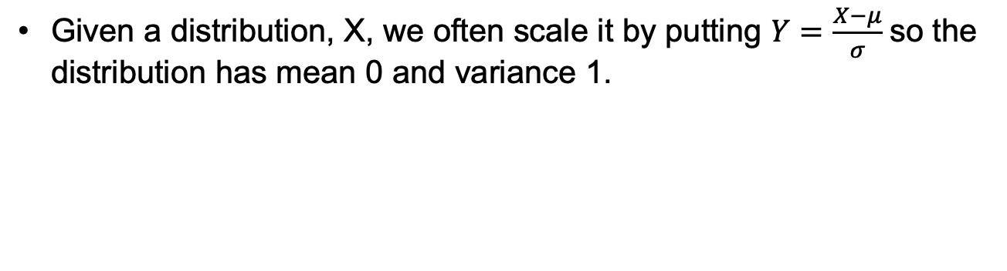
Rescaling and data conditioning
Given a distribution, X, we often scale it by putting $Y=\frac{X−μ}{σ}$ so the distribution has mean 0 and variance 1.

Slide 37
Data mining and analysis, part 4, some mathematical methods
Lagrange multipliers
Likelihood
Maximum likelihood estimation

Slide 38
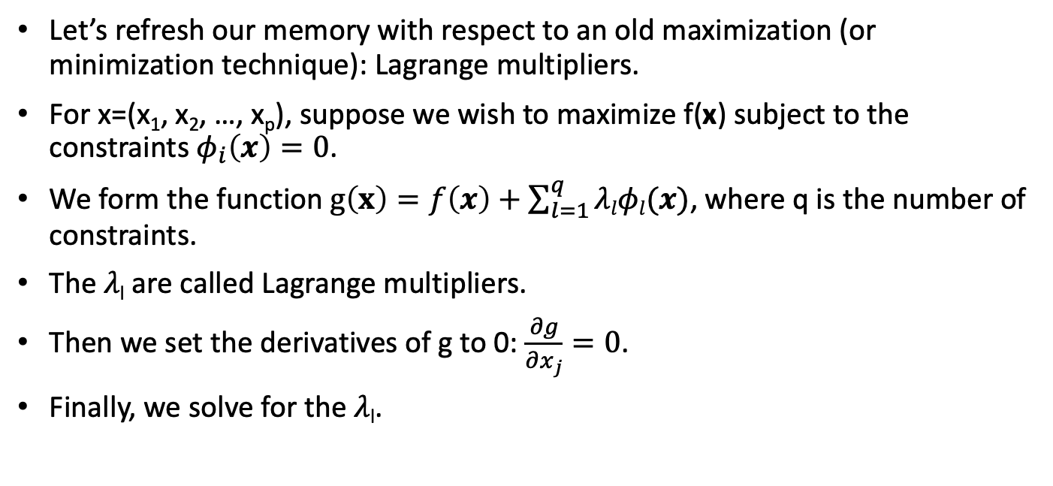
Lagrange multipliers
Let’s refresh our memory with respect to an old maximization (or minimization technique): Lagrange multipliers.
For x=(x₁, x₂, …, x_{p}), suppose we wish to maximize f(x) subject to the constraints $φ_{i}\left(x\right)=0$.
We form the function $g\left(x\right)=f\left(x\right)+\sum_{l=1}^{q}{λlφl(x)}$, where q is the number of constraints.
The 𝜆_{l} are called Lagrange multipliers.
Then we set the derivatives of g to 0: $\frac{∂g}{∂x_{j}}=0$.
Finally, we solve for the 𝜆_{l}.

Slide 39
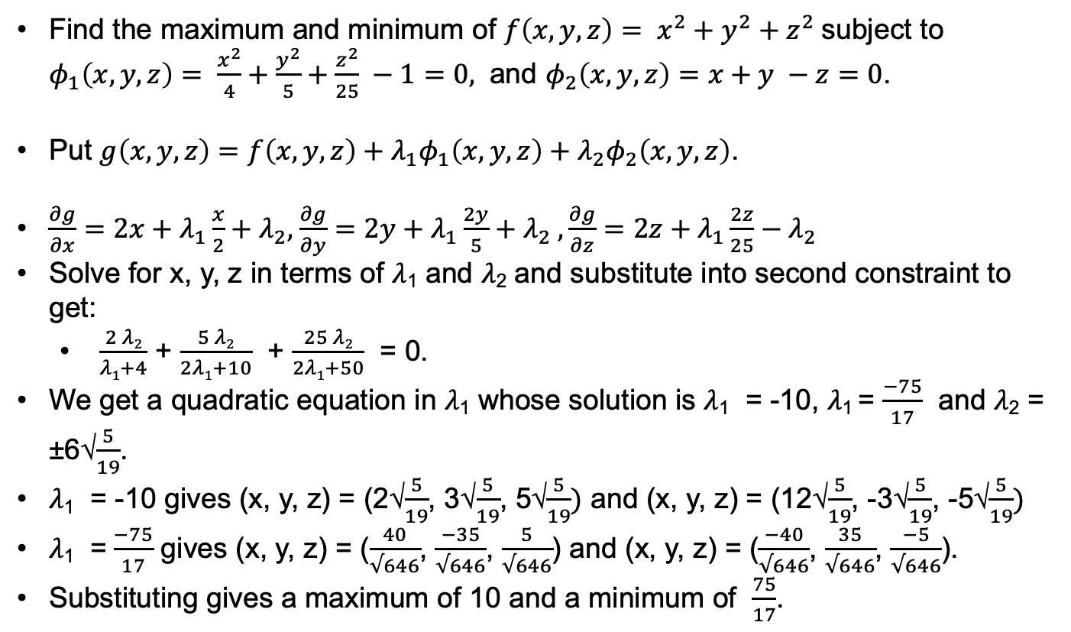
Lagrange multipliers: example
Find the maximum and minimum of $f\left(x, y, z\right)= x^{2}{+ y}^{2}{+ z}^{2}$subject to $φ_{1}\left(x, y, z\right)= \frac{x^{2}}{4}+\frac{y^{2}}{5}+\frac{z^{2}}{25} −1=0,$ and $φ_{2}\left(x, y, z\right)=x+y −z=0$.
Put $g\left(x,y,z\right)=f\left(x,y,z\right)+λ_{1}φ_{1}\left(x, y, z\right)+λ_{2}φ_{2}\left(x, y, z\right)$.
$\frac{∂g}{∂x}=2x+λ_{1}\frac{x}{2}+λ_{2},$ $\frac{∂g}{∂y}=2y+λ_{1}\frac{2y}{5}+λ_{2} ,\frac{∂g}{∂z}=2z+λ_{1}\frac{2z}{25}−λ_{2}$
Solve for x, y, z in terms of 𝜆₁ and 𝜆₂ and substitute into second constraint to get:
$\frac{2 λ2}{λ1+4}$ + $\frac{5 λ2}{2λ1+10}$ + $\frac{25 λ2}{2λ1+50}$ = 0.
We get a quadratic equation in 𝜆₁ whose solution is 𝜆₁ = -10, 𝜆₁ = $\frac{−75}{17}$ and 𝜆₂ = ±6√$\frac{5}{19}$.
𝜆₁ = -10 gives (x, y, z) = (2√$\frac{5}{19}$, 3√$\frac{5}{19}$, 5√$\frac{5}{19})$ and (x, y, z) = (12√$\frac{5}{19}$, -3√$\frac{5}{19}$, -5√$\frac{5}{19})$
𝜆₁ = $\frac{−75}{17}$ gives (x, y, z) = ($\frac{40}{√646}$, $\frac{−35}{√646}$, $\frac{5}{√646}$) and (x, y, z) = ($\frac{−40}{√646}$, $\frac{35}{√646}$, $\frac{−5}{√646}$).
Substituting gives a maximum of 10 and a minimum of $\frac{75}{17}$.

Slide 40
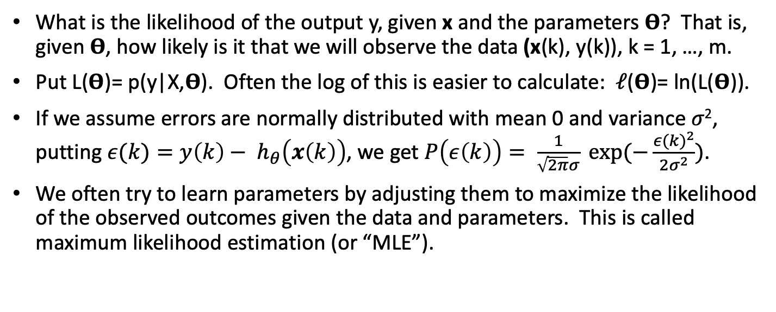
Likelihood
What is the likelihood of the output y, given x and the parameters 𝚹? That is, given 𝚹, how likely is it that we will observe the data (x(k), y(k)), k = 1, …, m.
Put L(𝚹)= p(y|X,𝚹). Often the log of this is easier to calculate: 𝓁(𝚹)= ln(L(𝚹)).
If we assume errors are normally distributed with mean 0 and variance 𝜎², putting $ε(k)=y\left(k\right)− h_{θ}\left(x\left(k\right)\right)$, we get $P\left(ε\left(k\right)\right)= \frac{1}{\sqrt{2π}σ} exp⁡(−\frac{{ε(k)}^{2}}{2σ^{2}})$.
We often try to learn parameters by adjusting them to maximize the likelihood of the observed outcomes given the data and parameters. This is called maximum likelihood estimation (or “MLE”).

Slide 41
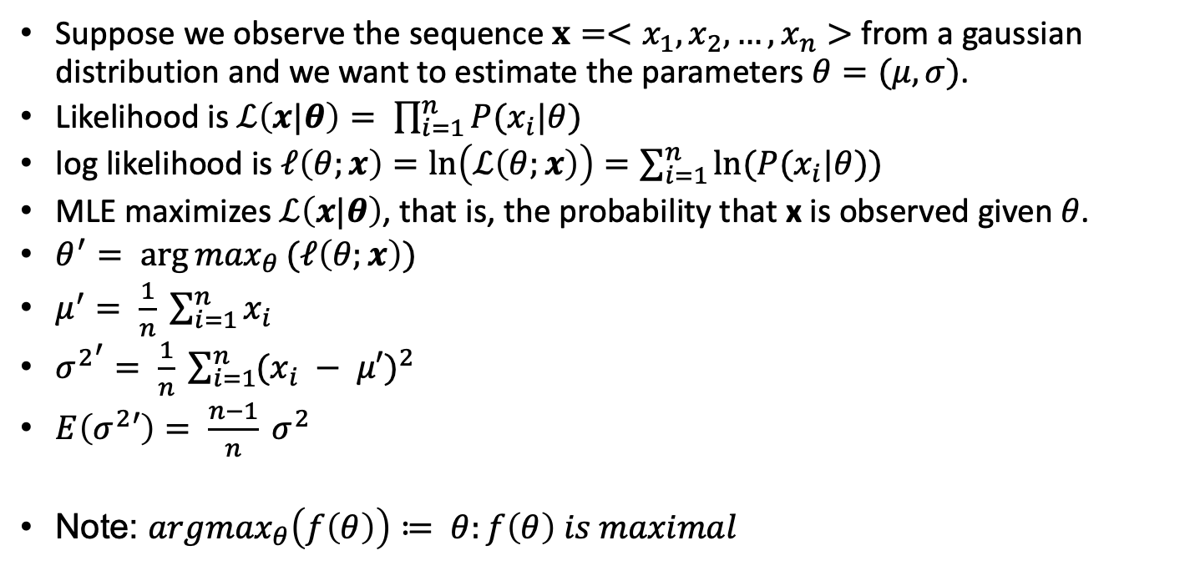
Maximum Likelihood Estimation (MLE)
Suppose we observe the sequence $x=<x_{1},x_{2}, …,x_{n}>$ from a gaussian distribution and we want to estimate the parameters $θ=(μ, σ)$.
Likelihood is $ℒ\left(x|θ\right)= \prod_{i=1}^{n}{P(x_{i}|θ)}$
log likelihood is $ℓ\left(θ;x\right)=\ln\left(ℒ\left(θ;x\right)\right)=\sum_{i=1}^{n}{ln⁡(P(x_{i}|θ))}$
MLE maximizes$ℒ\left(x|θ\right)$, that is, the probability that x is observed given 𝜃.
$θ^{′}= {\arg{max}}_{θ}(ℓ\left(θ;x\right))$
$μ^{′}= \frac{1}{n} \sum_{i=1}^{n}{x_{i}}$
${σ^{2}}^{′}= \frac{1}{n} \sum_{i=1}^{n}{{(x_{i} − μ′)}^{2}}$
$E\left(σ^{2}′\right)= \frac{n−1}{n} σ^{2}$
Note: ${argmax}_{θ}\left(f\left(θ\right)\right)≔ θ:f\left(θ\right) is maximal$

Slide 42
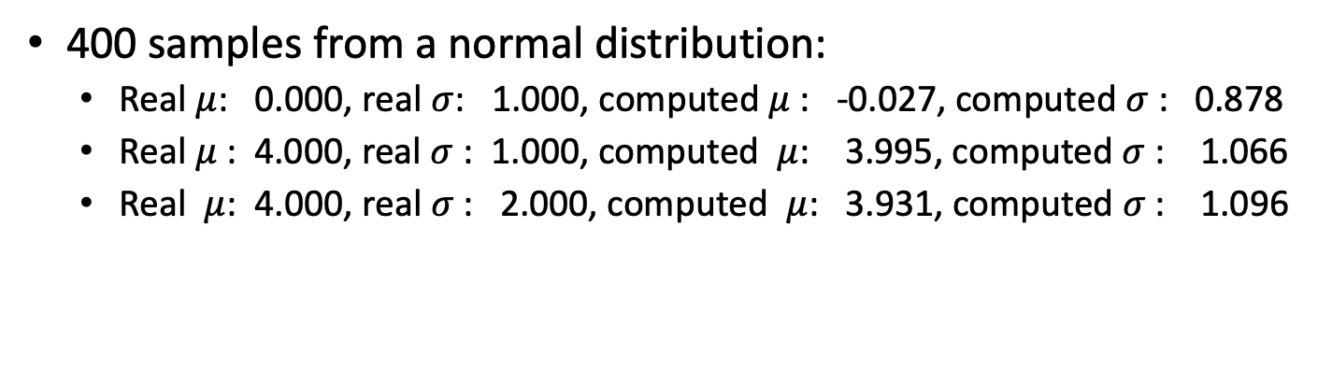
MLE example
MLE example
400 samples from a normal distribution:
Real $μ$: 0.000, real $σ$: 1.000, computed $μ$: -0.027, computed $σ$: 0.878
Real $μ$: 4.000, real $σ$: 1.000, computed $μ$: 3.995, computed $σ$: 1.066
Real $μ$: 4.000, real $σ$: 2.000, computed $μ$: 3.931, computed $σ$: 1.096

Slide 43
Data mining and analysis, part 5, logistic regression
Binary logistic regression
Sigmoid
Binary logistic regression
General logistic regression
General logistic regression
LDA

Slide 44
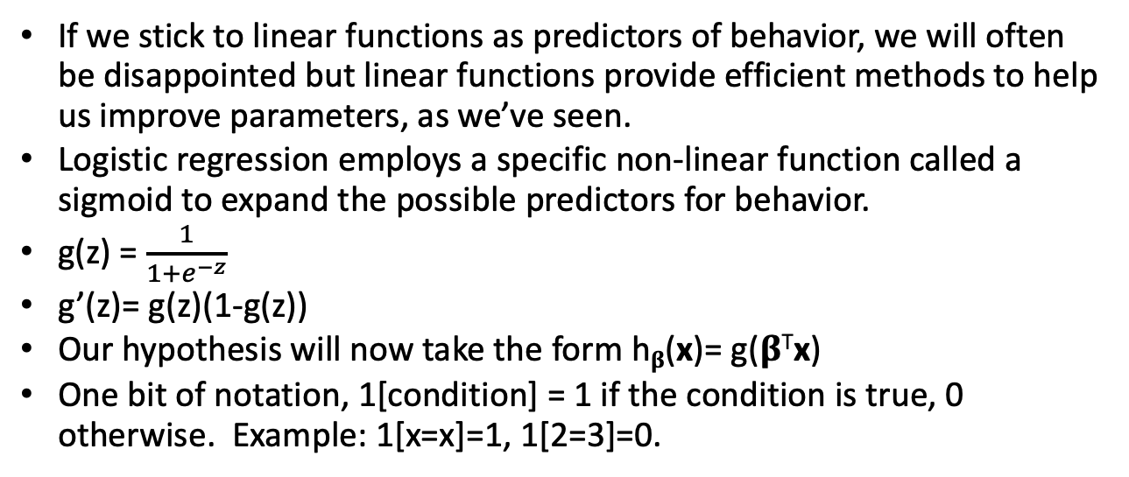
The sigmoid function
If we stick to linear functions as predictors of behavior, we will often be disappointed but linear functions provide efficient methods to help us improve parameters, as we’ve seen.
Logistic regression employs a specific non-linear function called a sigmoid to expand the possible predictors for behavior.
g(z) = $\frac{1}{1+e^{−z}}$
g’(z)= g(z)(1-g(z))
Our hypothesis will now take the form h_{𝛃}(x)= g(𝛃^{T}x)
One bit of notation, 1[condition] = 1 if the condition is true, 0 otherwise. Example: 1[x=x]=1, 1[2=3]=0.

Slide 45
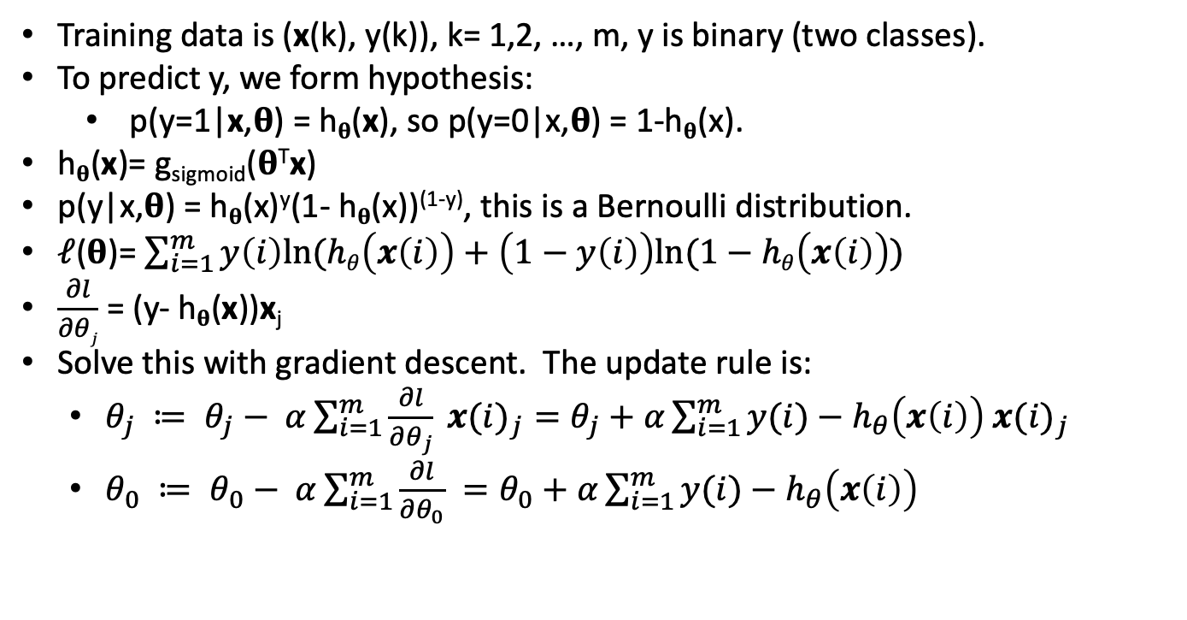
Binary logistic regression
Training data is (x(k), y(k)), k= 1,2, …, m, y is binary (two classes).
To predict y, we form hypothesis:
p(y=1|x,𝛉) = h_{𝛉}(x), so p(y=0|x,𝛉) = 1-h_{𝛉}(x).
h_{𝛉}(x)= g_{sigmoid}(𝛉^{T}x)
p(y|x,𝛉) = h_{𝛉}(x)^{y}(1- h_{𝛉}(x))^{(1-y)}, this is a Bernoulli distribution.
𝓁(𝛉)= $\sum_{i=1}^{m}{y\left(i\right)ln⁡(hθ\left(x\left(i\right)\right)+\left(1−y\left(i\right)\right)ln⁡(1−hθ\left(x\left(i\right)\right))}$
$\frac{∂l}{∂θj}$ = (y- h_{𝛉}(x))x_{j}
Solve this with gradient descent. The update rule is:
$θ_{j} ≔ θ_{j}− α\sum_{i=1}^{m}{\frac{∂l}{∂θ_{j}} {x(i)}_{j}=θ_{j}+α\sum_{i=1}^{m}{y(i)−h_{θ}\left(x\left(i\right)\right) {x(i)}_{j}}}$
$θ_{0} ≔ θ_{0}− α\sum_{i=1}^{m}{\frac{∂l}{∂θ_{0}} =θ_{0}+α\sum_{i=1}^{m}{y(i)−h_{θ}\left(x\left(i\right)\right) }}$

Slide 46
Binary logistic regression - example
Features in this example include: grade in previous class, hours of study, number of lectures attended. Want to predict whether you pass the class.
It’s important to normalize the data.
60 samples.
Features normalized and constant weight set to 1
Predicted parameters: -32.8078 (const), 37.1817 (previous grade), 25.0517 (hours studied), 26.4033 (lectures attended)
Results
features test 1: 1.0 0.77 (B+), 0.82 (33hrs), 0.90 (ratio of lectures) , prob pass: 1.0
features test 2: 1.0 0.22 (C-) 0.32 0.57 , prob pass: 0.19

Slide 47
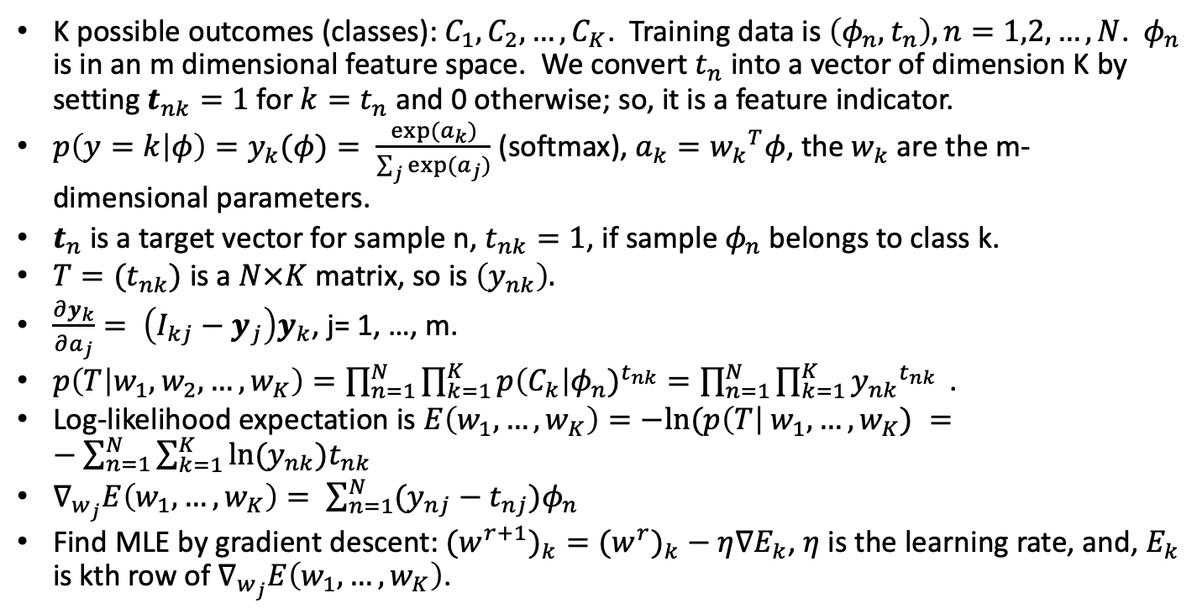
General logistic regression
K possible outcomes (classes): $C_{1},C_{2}, …,C_{K}$. Training data is $\left(φ_{n},t_{n}\right), n=1,2, …, N$. $φ_{n}$ is in an m dimensional feature space. We convert $t_{n}$ into a vector of dimension K by setting $t_{nk}=1$for $k=t_{n}$ and 0 otherwise; so, it is a feature indicator.
$p\left(y=k | φ\right)=y_{k}(φ)= \frac{exp⁡(a_{k})}{\sum_{j}{{exp⁡(a}_{j})}}$ (softmax), $a_{k}={w_{k}}^{T}φ$, the $w_{k}$ are the m-dimensional parameters.
$t_{n}$ is a target vector for sample n, $t_{nk}=1$, if sample $φ_{n}$ belongs to class k.
$T=(t_{nk})$ is a $N×K$ matrix, so is $\left(y_{nk}\right).$
$\frac{∂y_{k}}{∂a_{j}}= \left(I_{kj}−y_{j}\right)y_{k}$, j= 1, …, m.
$p\left(T | w_{1},w_{2},…,w_{K}\right)=\prod_{n=1}^{N}{\prod_{k=1}^{K}{{p\left(C_{k}\right|φ_{n})}^{t_{nk}}=\prod_{n=1}^{N}{\prod_{k=1}^{K}{{y_{nk}}^{t_{nk}}}} }}$.
Log-likelihood expectation is $E\left(w_{1}, …, w_{K}\right)=−ln⁡(p\left(T\right| w_{1}, …, w_{K}) =−\sum_{n=1}^{N}{\sum_{k=1}^{K}{ln⁡(y_{nk}{)t}_{nk}}}$
$∇_{w_{j}}E\left(w_{1}, …, w_{K}\right)= \sum_{n=1}^{N}{(y_{nj}−t_{nj})φ_{n}}$
Find MLE by gradient descent: ${{(w}^{r+1})}_{k}={{(w}^{r})}_{k}−η∇E_{k}$, $η$ is the learning rate, and, $E_{k}$ is kth row of $∇_{w_{j}}E\left(w_{1}, …, w_{K}\right)$.

Slide 48
General logistic regression example
Same data as binary logistic example but now we want to predict final grade.
Features normalized and constant weight set to 1. After run:
features test 1: 1.0000 0.7778 0.8250 0.9000
prediction: 0.0000(F), 0.0000(D), 0.0001(C-), 0.0004(C), 0.0069(C+),
0.1152(B-), 0.2146(B), 0.2492(B+), 0.2271(A-), 0.1866(A)
features test 2: 1.0000 0.2222 0.3250 0.5667,
prediction: 0.0821(F), 0.1745(D), 0.1730(C-), 0.1746(C), 0.0957(C+),
0.1289(B-), 0.0133(B), 0.1578(B+), 0.0000(A-), 0.0000(A)

Slide 49
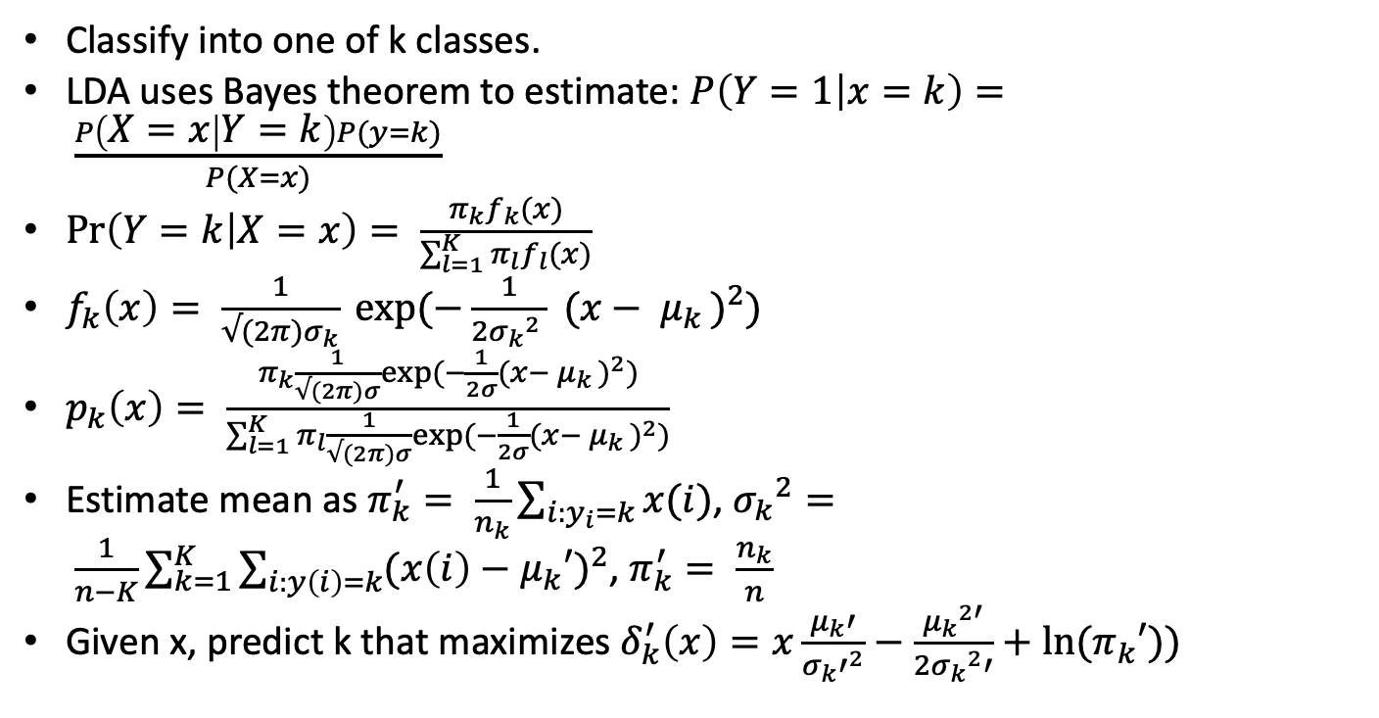
Linear Discrimination Analysis (LDA)
Classify into one of k classes.
LDA uses Bayes theorem to estimate: $P\left(Y=1 | x=k\right)= \frac{P\left(X=x | Y=k\right)P(y=k)}{P(X=x)}$
$\operatorname{Pr}\left(Y=k | X=x\right)= \frac{π_{k}f_{k}(x)}{\sum_{l=1}^{K}{π_{l}f_{l}(x)}}$
$f_{k}\left(x\right)= \frac{1}{√(2π)σ_{k}} exp⁡(−\frac{1}{2{σ_{k}}^{2} } {(x− μ_{k })}^{2})$
$p_{k}\left(x\right)= \frac{π_{k}\frac{1}{√(2π)σ}exp⁡(−\frac{1}{2σ}{(x− μ_{k })}^{2})}{\sum_{l=1}^{K}{π_{l}\frac{1}{√(2π)σ}exp⁡(−\frac{1}{2σ}{(x− μ_{k })}^{2})}}$
Estimate mean as $π_{k}^{′}= \frac{1}{n_{k}}\sum_{i:y_{i}=k}{x(i)}$, ${σ_{k}}^{2}= \frac{1}{n−K}\sum_{k=1}^{K}{\sum_{i:y\left(i\right)=k}{{(x\left(i\right)−μ_{k}′)}^{2}}}$, $π_{k}^{′}= \frac{n_{k}}{n}$
Given x, predict k that maximizes $δ_{k}^{′}\left(x\right)=x\frac{μ_{k}′}{{σ_{k}′}^{2}}−\frac{{μ_{k}}^{2′}}{2{σ_{k}}^{2}′}+ln⁡(π_{k}′))$

Slide 50
LDA example
Same data as logistic example but now we want to predict final grade.
We are given an initial grade distribution.
Todo

Slide 51
Data mining and analysis, part 6, classification
Classification
Naïve Bayes
Laplace smoothing
KNN
SVM
Optimization and margins
Duality
Regularization
Platt’s SMO
What happens if there’s not a separating hyperplane?

Slide 52
Classification: overview
Classification seeks to predict the category of an observed data set. Medical diagnosis is an example. For example, given a set of symptoms, syndromes and medical tests, does a patient have the flu, meningitis, AIDS? There are several ways to judge classification efficacy. Let TP be the number of true positive predictions, TN be the number of true negative predictions, FP be the number of false positive predictions, and FN be the number of false negative predictions in a set of experiments.
Accuracy is defined as: (TP+TN)/(TP+TN+FP+FN)
Precision is defined as : TP/(TP+FP)
Recall is defined as: TP/(TP+FN)
We’ll study several classification methods including:
Naïve Bayes
Support Vector Machines (SVM)
Neural networks

Slide 53
Naïve naïve Bayes
Suppose X= (X₁, X₂, …, X_{r}) and we wish to either predict an outcome or classify a characteristic based on a collection of training data (x(k), y(k)) like the data on the right. Here, we are trying to guess whether someone will evade taxes. But this method works when Y can take on more than two values.
We assume conditional independence: P(X₁,X₂,…X_{r}|Y)= P(X₁|Y) P(X₂|Y)…P(X_{r}|Y) --- this is the “naïve” part.
P(Y|X)= P(X|Y)P(Y)/P(X) by Bayes rule. Using conditional independence, it’s easy to see we have all the required information for the calculation of P(Y|X).
For example, P(evade=Yes|Yes, S,125) = P(Yes|yes)P(Yes|S)P(Yes|125)/P(yes,S,125).
This example uses very little training data and one of the features (income) is continuous. We can put continuous feature values into buckets to carry out the analysis or, model them as normal distributions with parameters.
Refund | Status | Income | Evade
Yes | S | 125 | No
No | M | 100 | No
No | S | 70 | No
Yes | M | 120 | No
No | D | 95 | Yes
No | M | 60 | No
Yes | D | 220 | No
No | S | 85 | Yes
No | M | 75 | No
No | S | 90 | Yes
From Tan, Steinbach, et al

Slide 54
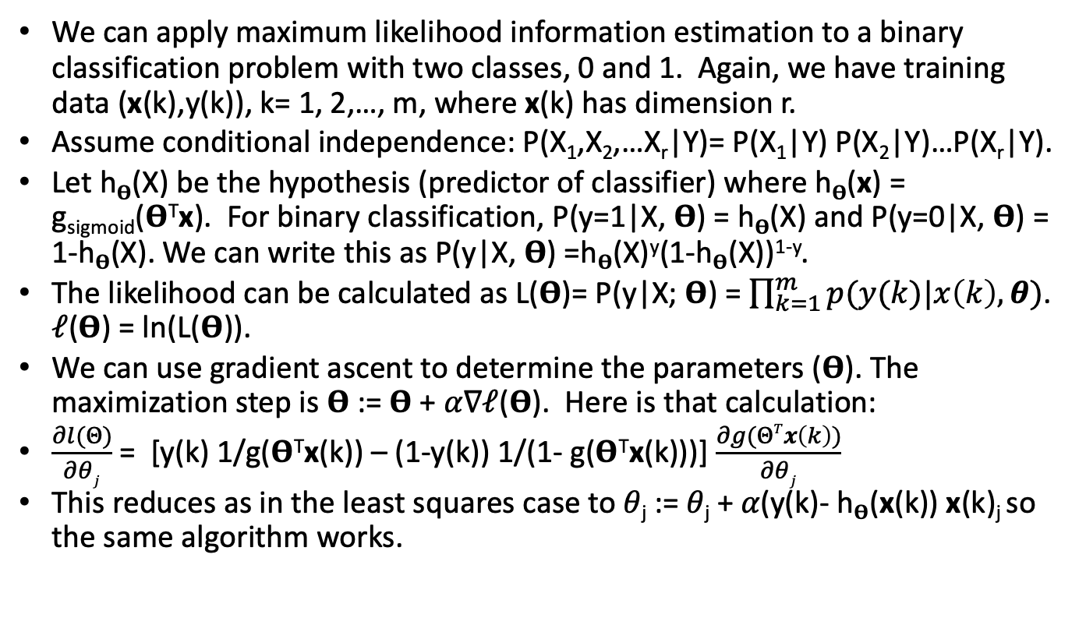
Naïve Bayes: fancier treatment
We can apply maximum likelihood information estimation to a binary classification problem with two classes, 0 and 1. Again, we have training data (x(k),y(k)), k= 1, 2,…, m, where x(k) has dimension r.
Assume conditional independence: P(X₁,X₂,…X_{r}|Y)= P(X₁|Y) P(X₂|Y)…P(X_{r}|Y).
Let h_{𝚹}(X) be the hypothesis (predictor of classifier) where h_{𝚹}(x) = g_{sigmoid}(𝚹^{T}x). For binary classification, P(y=1|X, 𝚹) = h_{𝚹}(X) and P(y=0|X, 𝚹) = 1-h_{𝚹}(X). We can write this as P(y|X, 𝚹) =h_{𝚹}(X)^{y}(1-h_{𝚹}(X))^{1-y}.
The likelihood can be calculated as L(𝚹)= P(y|X; 𝚹) = $\prod_{k=1}^{m}{p(y(k)|x\left(k\right),θ)}$. 𝓁(𝚹) = ln(L(𝚹)).
We can use gradient ascent to determine the parameters (𝚹). The maximization step is 𝚹 := 𝚹 + 𝛼∇𝓁(𝚹). Here is that calculation:
$\frac{∂l(Θ)}{∂θj}$ = [y(k) 1/g(𝚹^{T}x(k)) – (1-y(k)) 1/(1- g(𝚹^{T}x(k)))] $\frac{∂g(ΘTx\left(k\right))}{∂θj}$
This reduces as in the least squares case to 𝜃_{j} := 𝜃_{j} + 𝛼(y(k)- h_{𝚹}(x(k)) x(k)_{j} so the same algorithm works.

Slide 55
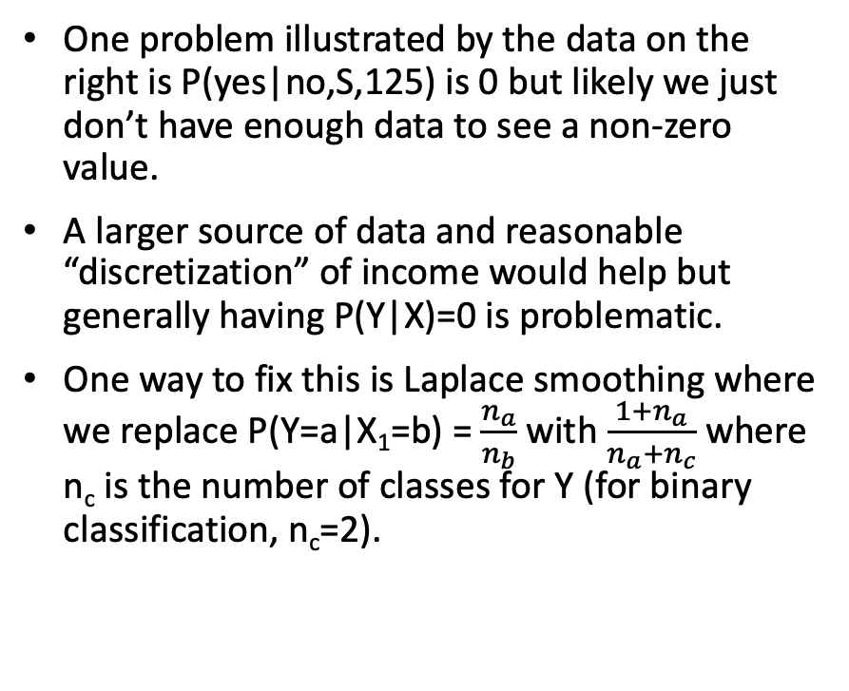
Naïve Bayes: Laplace smoothing
One problem illustrated by the data on the right is P(yes|no,S,125) is 0 but likely we just don’t have enough data to see a non-zero value.
A larger source of data and reasonable “discretization” of income would help but generally having P(Y|X)=0 is problematic.
One way to fix this is Laplace smoothing where we replace P(Y=a|X₁=b) = $\frac{n_{a}}{n_{b}}$ with $\frac{{1+n}_{a}}{n_{a}+n_{c}}$ where n_{c} is the number of classes for Y (for binary classification, n_{c}=2).
Refund | Status | Income | Evade
Yes | S | 125 | No
No | M | 100 | No
No | S | 70 | No
Yes | M | 120 | No
No | D | 95 | Yes
No | M | 60 | No
Yes | D | 220 | No
No | S | 85 | Yes
No | M | 75 | No
No | S | 90 | Yes
Data from Tan, Steinbach, et al

Slide 56
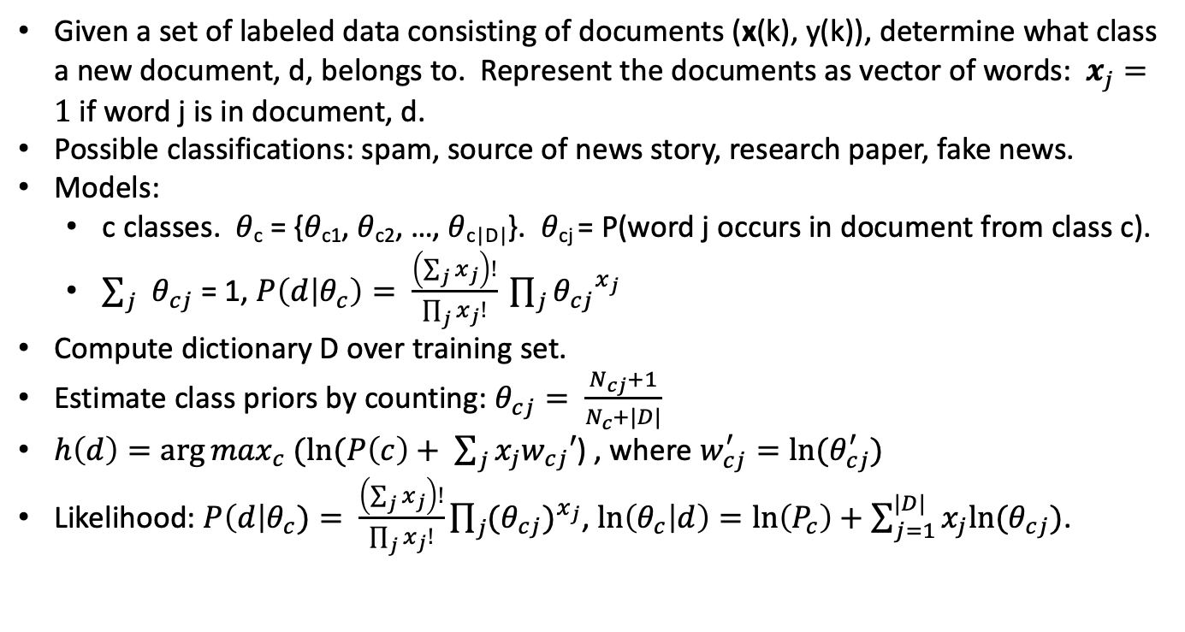
Example: Document classification using Naïve Bayes
Given a set of labeled data consisting of documents (x(k), y(k)), determine what class a new document, d, belongs to. Represent the documents as vector of words: $x_{j}=1$ if word j is in document, d.
Possible classifications: spam, source of news story, research paper, fake news.
Models:
c classes. 𝜃_{c} = {𝜃_{c1}, 𝜃_{c2}, …, 𝜃_{c|D|}}. 𝜃_{cj} = P(word j occurs in document from class c).
$\sum_{j}{θ_{cj}}$ = 1, $P\left(d | θ_{c}\right)= \frac{\left(\sum_{j}{x_{j}}\right)!}{\prod_{j}{x_{j}!}} \prod_{j}{{θ_{cj}}^{x_{j}}}$
Compute dictionary D over training set.
Estimate class priors by counting: $θ_{cj}= \frac{N_{cj}+1}{N_{c}+|D|}$
$h\left(d\right)=\arg{\max_{c} (ln⁡(P\left(c\right)+ \sum_{j}{x_{j}w_{cj}′}}$) , where $w_{cj}^{′}=ln⁡(θ_{cj}^{′})$
Likelihood: $P\left(d\right|θ_{c})= \frac{\left(\sum_{j}{x_{j}}\right)!}{\prod_{j}{x_{j}!}}\prod_{j}{{(θ_{cj})}^{x_{j}}}$, $\ln\left(θ_{c} | d\right)=\ln\left(P_{c}\right)+\sum_{j=1}^{|D|}{x_{j}ln⁡(θ_{cj})}$.
Credit: Alina Opera

Slide 57
kNN
Find k nearest points to x in training set.
Use majority vote.
Somewhat computationally expensive during operational phase.

Slide 58
Classification: SVM
Imagine we have two classes we wish to predict from data.
In the picture on the right, data points are colored to indicate whether they represent a “red” characteristic or a “blue” characteristic. In this case, the red and blue class is separated by a line (more generally, a hyperplane) and the “learning” problem is to determine the hyperplane, separating the values for which the minimum distance from the points and the hyperplane and which side of the hyperplane determines which characteristics.
The margin is the minimum distance from data points and the separating hyperplane. The margin could be measured vertically, horizontally or orthogonally to the hyperplane.
Some background: A hyperspace in R^{p} is the set of points, x, satisfying w₁x₁ + w₂x₂ + … + w_{p}x_{p} + w₀ = 0. One side of the hyperplane consists of the points, x, such that w₁x₁ + w₂x₂ + … + w_{p}x_{p} + w₀ > 0 and the other side consists of the points, x, such that w₁x₁ + w₂x₂ + … + w_{p}x_{p} + w₀ < 0.

Slide 59
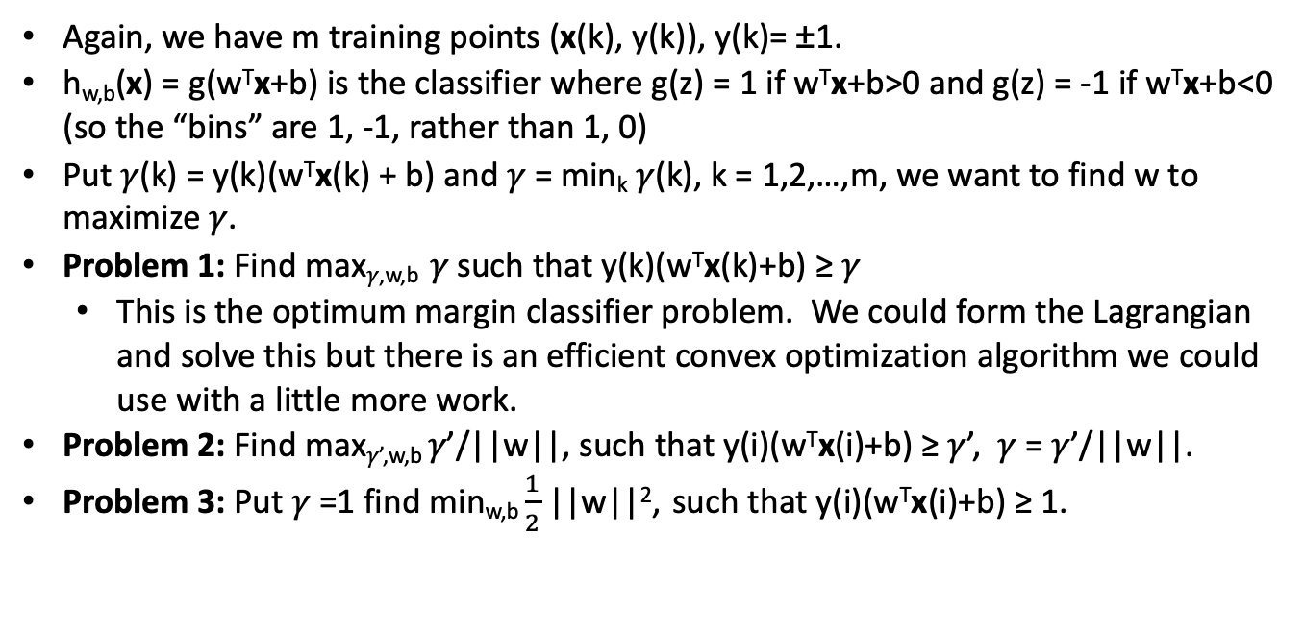
SVM: Optimization problem
Again, we have m training points (x(k), y(k)), y(k)= ±1.
h_{w,b}(x) = g(w^{T}x+b) is the classifier where g(z) = 1 if w^{T}x+b>0 and g(z) = -1 if w^{T}x+b<0 (so the “bins” are 1, -1, rather than 1, 0)
Put 𝛾(k) = y(k)(w^{T}x(k) + b) and 𝛾 = min_{k} 𝛾(k), k = 1,2,…,m, we want to find w to maximize 𝛾.
Problem 1: Find max_{𝛾,w,b} 𝛾 such that y(k)(w^{T}x(k)+b) ≥ 𝛾
This is the optimum margin classifier problem. We could form the Lagrangian and solve this but there is an efficient convex optimization algorithm we could use with a little more work.
Problem 2: Find max_{𝛾’,w,b} 𝛾’/||w||, such that y(i)(w^{T}x(i)+b) ≥ 𝛾’, 𝛾 = 𝛾’/||w||.
Problem 3: Put 𝛾 =1 find min_{w,b} $\frac{1}{2}$ ||w||², such that y(i)(w^{T}x(i)+b) ≥ 1.

Slide 60
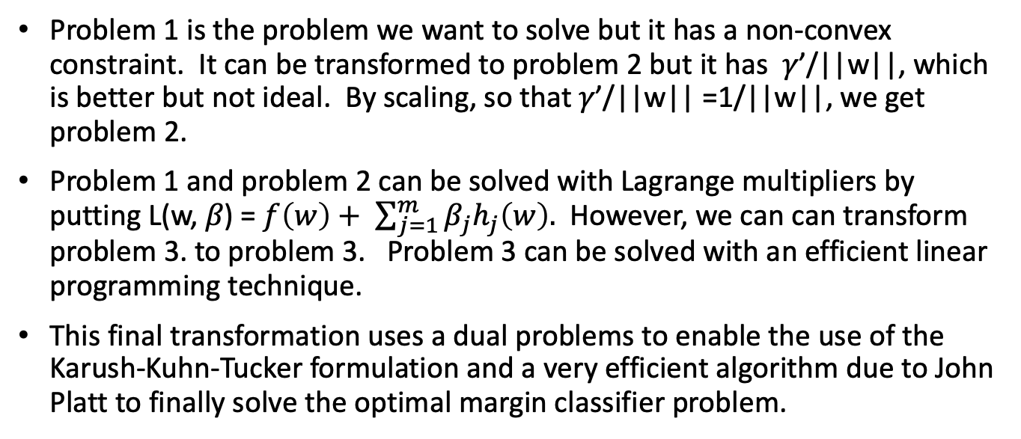
SVM: Optimization problem
Problem 1 is the problem we want to solve but it has a non-convex constraint. It can be transformed to problem 2 but it has 𝛾’/||w||, which is better but not ideal. By scaling, so that 𝛾’/||w|| =1/||w||, we get problem 2.
Problem 1 and problem 2 can be solved with Lagrange multipliers by putting L(w, 𝛽) = $f\left(w\right)+ \sum_{j=1}^{m}{β_{j}h_{j}\left(w\right).}$ However, we can can transform problem 3. to problem 3. Problem 3 can be solved with an efficient linear programming technique.
This final transformation uses a dual problems to enable the use of the Karush-Kuhn-Tucker formulation and a very efficient algorithm due to John Platt to finally solve the optimal margin classifier problem.

Slide 61
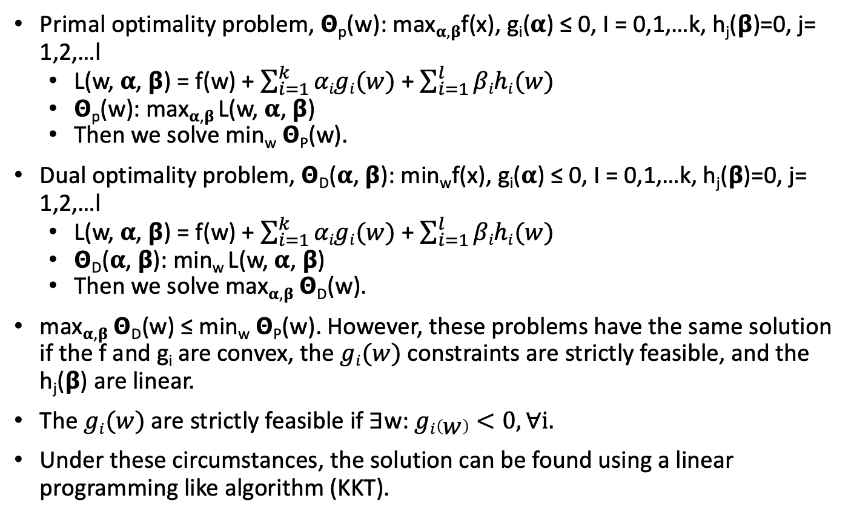
SVM: Lagrange Duality
Primal optimality problem, 𝝝_{p}(w): max_{𝛂,𝛃}f(x), g_{i}(𝛂) ≤ 0, I = 0,1,…k, h_{j}(𝝱)=0, j= 1,2,…l
L(w, 𝛂, 𝝱) = f(w) + $\sum_{i=1}^{k}{αigi(w)}$ + $\sum_{i=1}^{l}{βihi(w)}$
𝝝_{p}(w): max_{𝛂,𝛃} L(w, 𝛂, 𝝱)
Then we solve min_{w} 𝝝_{P}(w).
Dual optimality problem, 𝝝_{D}(𝛂, 𝝱): min_{w}f(x), g_{i}(𝛂) ≤ 0, I = 0,1,…k, h_{j}(𝝱)=0, j= 1,2,…l
L(w, 𝛂, 𝝱) = f(w) + $\sum_{i=1}^{k}{αigi(w)}$ + $\sum_{i=1}^{l}{βihi(w)}$
𝝝_{D}(𝛂, 𝝱): min_{w} L(w, 𝛂, 𝝱)
Then we solve max_{𝛂,𝛃} 𝝝_{D}(w).
max_{𝛂,𝛃} 𝝝_{D}(w) ≤ min_{w} 𝝝_{P}(w). However, these problems have the same solution if the f and g_{i} are convex, the $gi(w)$ constraints are strictly feasible, and the h_{j}(𝝱) are linear.
The $gi(w)$ are strictly feasible if ∃w: $gi\left(w\right)<0, ∀i.$
Under these circumstances, the solution can be found using a linear programming like algorithm (KKT).

Slide 62
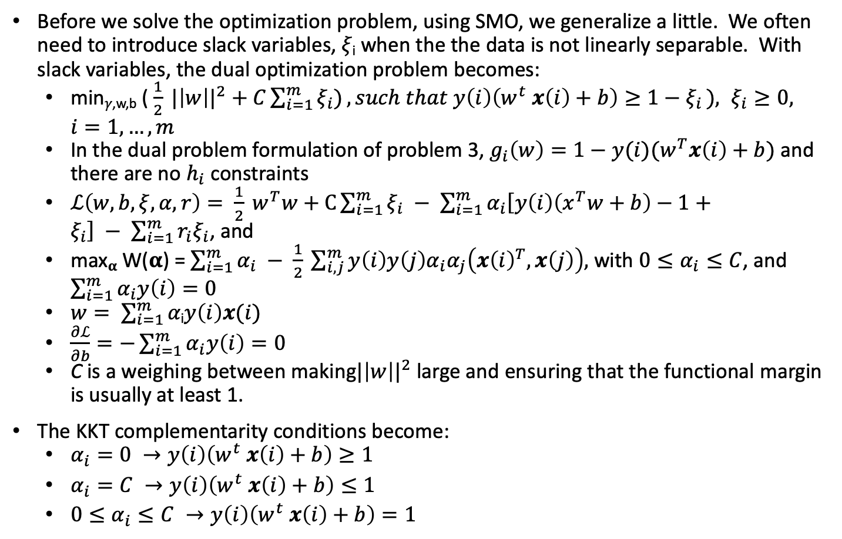
Regularization
Before we solve the optimization problem, using SMO, we generalize a little. We often need to introduce slack variables, 𝜉_{i} when the the data is not linearly separable. With slack variables, the dual optimization problem becomes:
min_{𝛾,w,b} ( $\frac{1}{2} {|\left|w\right||}^{2}+C\sum_{i=1}^{m}{ξ_{i})}, such that y\left(i\right)\left(w^{t} x\left(i\right)+b\right)≥1−ξ_{i }), ξ_{i}≥0, i=1,…,m$
In the dual problem formulation of problem 3, $g_{i}\left(w\right)=1−y(i)(w^{T}x\left(i\right)+b)$ and there are no $h_{i}$ constraints
$ℒ\left(w,b,ξ,α,r\right)= \frac{1}{2} w^{T}w+C\sum_{i=1}^{m}{ξ_{i} − \sum_{i=1}^{m}{α_{i}\left[y\left(i\right)\left(x^{T}w+b\right)−1+ξ_{i}\right] − \sum_{i=1}^{m}{r_{i}ξ_{i}}}}$, and
max_{𝛂} W(𝛂) = $\sum_{i=1}^{m}{α_{i} − \frac{1}{2} \sum_{i,j}^{m}{y\left(i\right)y\left(j\right)α_{i}α_{j}\left({x\left(i\right)}^{T}, x\left(j\right)\right), }}$ with $0≤α_{i}≤C$, and $\sum_{i=1}^{m}{α_{i}y\left(i\right)=0}$
$w= \sum_{i=1}^{m}{\text{α}\text{i}y\left(i\right)x(i)}$
$\frac{∂ℒ}{∂b}=−\sum_{i=1}^{m}{α_{i}y\left(i\right)=0}$
C is a weighing between making${|\left|w\right||}^{2}$ large and ensuring that the functional margin is usually at least 1.
The KKT complementarity conditions become:
$α_{i}=0 →y\left(i\right)\left(w^{t} x\left(i\right)+b\right)≥1$
$α_{i}=C →y\left(i\right)\left(w^{t} x\left(i\right)+b\right)≤1$
${0≤α}_{i}≤C →y\left(i\right)\left(w^{t} x\left(i\right)+b\right)=1$

Slide 63
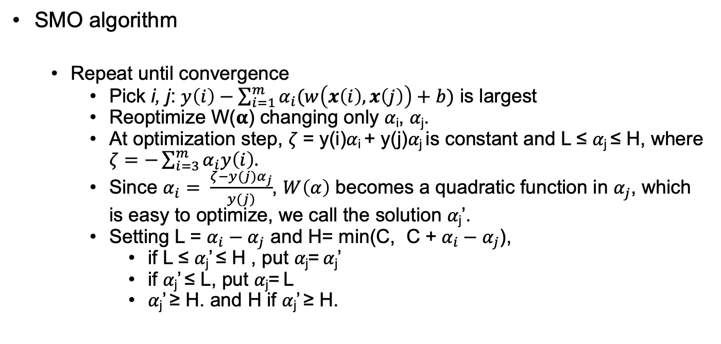
Platt’s sequential minimal optimization (SMO) algorithm
SMO algorithm
Repeat until convergence
Pick i, j: $y\left(i\right)−\sum_{i=1}^{m}{α_{i}(w\left(x\left(i\right), x\left(j\right)\right)+b)}$ is largest
Reoptimize W(𝛂) changing only 𝛼_{i}, 𝛼_{j}.
At optimization step, 𝜁 = y(i)𝛼_{i} + y(j)𝛼_{j} is constant and L ≤ 𝛼_{j} ≤ H, where $ζ=−\sum_{i=3}^{m}{α_{i}y\left(i\right).}$
Since $α_{i}= \frac{ζ−y(j)α_{j}}{y(j)}$, $W\left(α\right)$ becomes a quadratic function in $α_{j}$, which is easy to optimize, we call the solution 𝛼_{j}’.
Setting L = $α_{i}−α_{j}$ and H= min(C, C + $α_{i}−α_{j}$),
if L ≤ 𝛼_{j}’ ≤ H , put 𝛼_{j}= 𝛼_{j}’
if 𝛼_{j}’ ≤ L, put 𝛼_{j}= L
𝛼_{j}’ ≥ H. and H if 𝛼_{j}’ ≥ H.

Slide 64
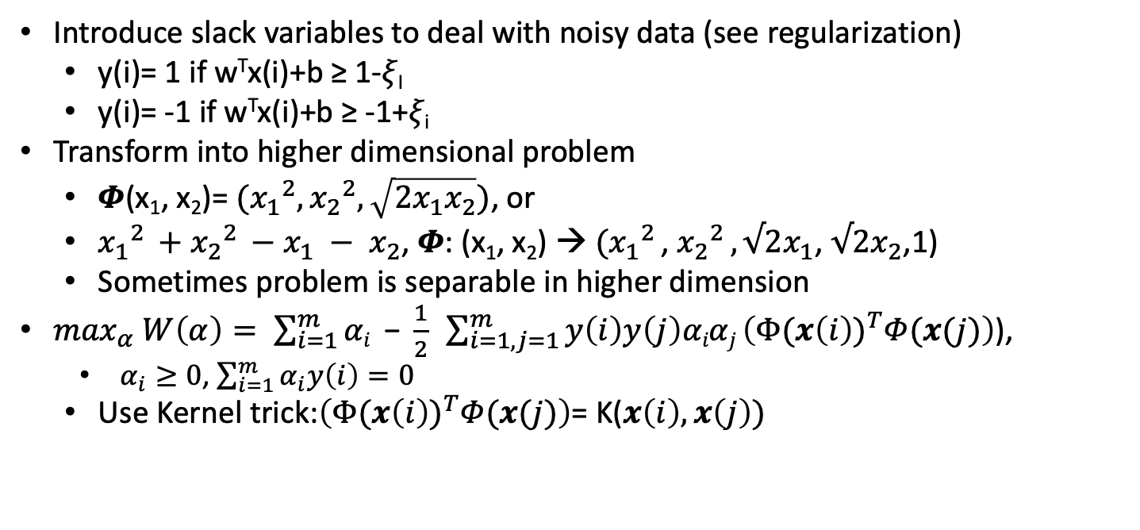
What happens when there is not a separating hyperplane?
Introduce slack variables to deal with noisy data (see regularization)
y(i)= 1 if w^{T}x(i)+b ≥ 1-𝜉_{I}
y(i)= -1 if w^{T}x(i)+b ≥ -1+𝜉_{i}
Transform into higher dimensional problem
𝜱(x₁, x₂)= $({x_{1}}^{2},{x_{2}}^{2}, \sqrt{2x_{1}x_{2}})$, or
${x_{1}}^{2 }+{x_{2}}^{2 }−x_{1} − x_{2}$, 𝜱: (x₁, x₂) → $({x_{1}}^{2 }$, ${x_{2}}^{2 }, √2x_{1}$, $√2x_{2}$,1)
Sometimes problem is separable in higher dimension
$\max_{α} W\left(α\right)= \sum_{i=1}^{m}{αi}\text{ − }\frac{1}{2} \sum_{i=1, j=1}^{m}{y\left(i\right)y\left(j\right)αiαj \left(Φ({x\left(i\right))}^{T}Φ(x(j)\right)}$),
$α_{i}≥0$, $\sum_{i=1}^{m}{α_{i}y\left(i\right)=0}$
Use Kernel trick:$\left(Φ({x\left(i\right))}^{T}Φ(x(j)\right)$= K($x\left(i\right),x\left(j\right))$

Slide 65
SVM example
w^{T}x + b = 0, x = (x, y)
w: (0.4961, 0.8682), b: 0.0000
test point: (8.0000, 8.0000), w: (0.4961, 0.8682), b: 0
Prediction 1: 1.00
test point: (-8.0000, -8.0000), w: (0.4961, 0.8682), b: 0
Prediction 2 : -1.00

Slide 66
Another SVM example
Todo

Slide 67
Data mining and analysis, part 7, Likelihood maximization
EM algorithm
Gaussian mixtures
Markov chains

Slide 68
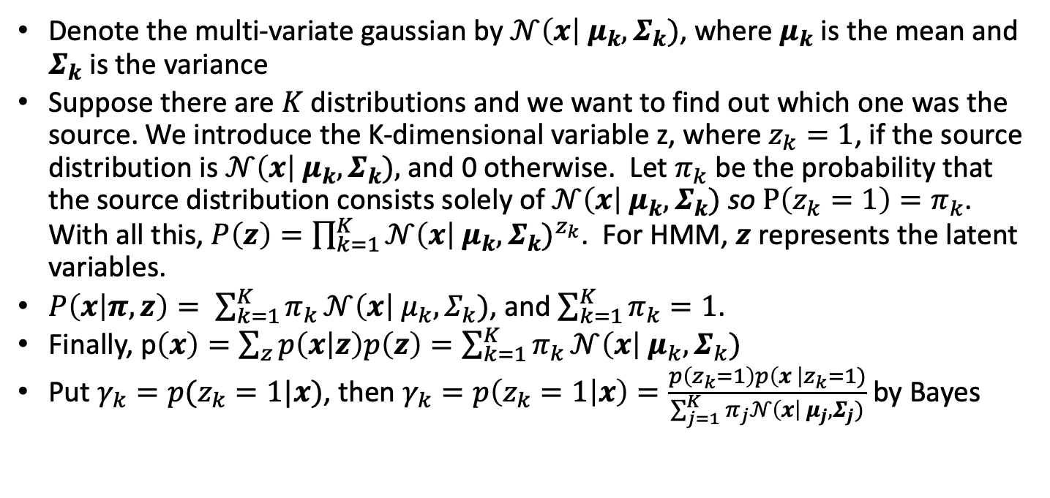
Gaussian mixture and the EM Algorithm
Denote the multi-variate gaussian by $𝒩\left(x\right| μ_{k}, Σ_{k})$, where $μ_{k}$ is the mean and $Σ_{k}$ is the variance
Suppose there are $K$ distributions and we want to find out which one was the source. We introduce the K-dimensional variable z, where $z_{k}=1$, if the source distribution is $𝒩\left(x\right| μ_{k}, Σ_{k}),$ and 0 otherwise. Let $π_{k}$ be the probability that the source distribution consists solely of $𝒩\left(x\right| μ_{k}, Σ_{k})$ so $P\left(z_{k}=1\right)=π_{k}$. With all this, $P\left(z\right)=\prod_{k=1}^{K}{{𝒩\left(x\right| μ_{k}, Σ_{k})}^{z_{k}}}$. For HMM, $z$ represents the latent variables.
$P\left(x | π,z\right)= \sum_{k=1}^{K}{π_{k}}𝒩\left(x\right| μ_{k}, Σ_{k})\text{,}$ and $\sum_{k=1}^{K}{π_{k}=1}$.
Finally, p$\left(x\right)=\sum_{z}{p\left(x | z\right)p\left(z\right)=\sum_{k=1}^{K}{π_{k}}𝒩\left(x\right| μ_{k}, Σ_{k})}$
Put $γ_{k}=p(z_{k}=1|x)$, then $γ_{k}=p\left(z_{k}=1 | x\right)=\frac{p\left(z_{k}=1\right)p\left(x \right|z_{k}=1)}{\sum_{j=1}^{K}{π_{j}}𝒩\left(x\right| μ_{j}, Σ_{j})}$ by Bayes

Slide 69
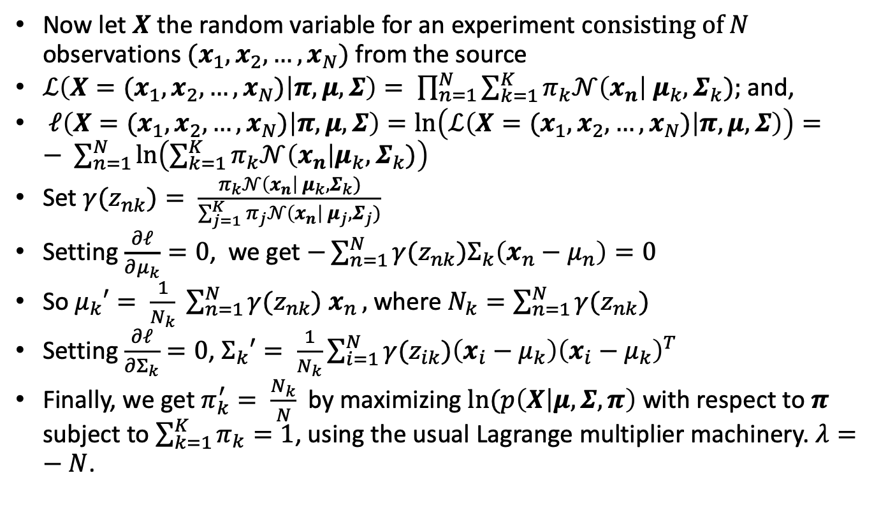
Gaussian mixture and the EM Algorithm
Now let $X$ the random variable for an experiment c$onsisting of N$ observations $(x_{1},x_{2},…,x_{N})$ from the source
$ℒ\left(X=(x_{1},x_{2},…,x_{N}) | π,μ,Σ\right)= \prod_{n=1}^{N}{\sum_{k=1}^{K}{π_{k}𝒩\left(x_{n}\right| μ_{k}, Σ_{k});}}$ and,
$ℓ\left(X=(x_{1},x_{2},…,x_{N}) | π,μ,Σ\right)=\ln\left(ℒ\left(X=(x_{1},x_{2},…,x_{N}) | π,μ,Σ\right)\right)=− \sum_{n=1}^{N}{\ln\left(\sum_{k=1}^{K}{π_{k}𝒩\left(x_{n}\right|μ_{k}, Σ_{k})}\right)}$
Set ${γ(z}_{nk})= \frac{π_{k}𝒩\left(x_{n}\right| μ_{k}, Σ_{k})}{\sum_{j=1}^{K}{π_{j}𝒩\left(x_{n}\right| μ_{j}, Σ_{j})}}$
Setting $\frac{∂ℓ}{∂μ_{k}}=0$, we get $−\sum_{n=1}^{N}{{γ(z}_{nk})Σ_{k}\left(x_{n}−μ_{n}\right)=0}$
So $μ_{k}′= \frac{1}{N_{k}} \sum_{n=1}^{N}{γ(z_{nk}) x_{n}},$ where $N_{k}=\sum_{n=1}^{N}{{γ(z}_{nk})}$
Setting $\frac{∂ℓ}{∂Σ_{k}}=0$, $Σ_{k}′= \frac{1}{N_{k}}\sum_{i=1}^{N}{γ(z_{ik})\left(x_{i}−μ_{k}\right){\left(x_{i}−μ_{k}\right)}^{T}}$
Finally, we get $π_{k}^{′}= \frac{N_{k}}{N}$ by maximizing $ln⁡(p\left(X | μ,Σ, π\right)$ with respect to $π$ subject to $\sum_{k=1}^{K}{π_{k}=1}$, using the usual Lagrange multiplier machinery. $λ=−N$.

Slide 70
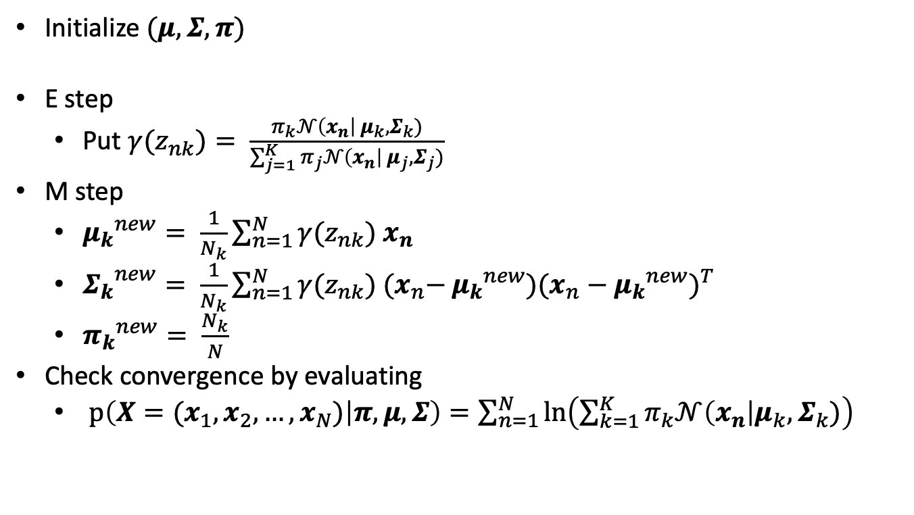
Summary EM for Gaussian Mixing
Initialize $(μ, Σ, π)$
E step
Put ${γ(z}_{nk})= \frac{π_{k}𝒩\left(x_{n}\right| μ_{k}, Σ_{k})}{\sum_{j=1}^{K}{π_{j}𝒩\left(x_{n}\right| μ_{j}, Σ_{j})}}$
M step
${μ_{k}}^{new}= \frac{1}{N_{k}}\sum_{n=1}^{N}{{γ(z}_{nk}) x_{n}}$
${Σ_{k}}^{new}= \frac{1}{N_{k}}\sum_{n=1}^{N}{{γ(z}_{nk}) {(x}_{n}−}{μ_{k}}^{new}){(x_{n}−{μ_{k}}^{new})}^{T}$
${π_{k}}^{new}= \frac{N_{k}}{N}$
Check convergence by evaluating
$p\left(X=(x_{1},x_{2},…,x_{N}) | π,μ,Σ\right)=\sum_{n=1}^{N}{\ln\left(\sum_{k=1}^{K}{π_{k}𝒩\left(x_{n}\right|μ_{k}, Σ_{k})}\right)}$

Slide 71
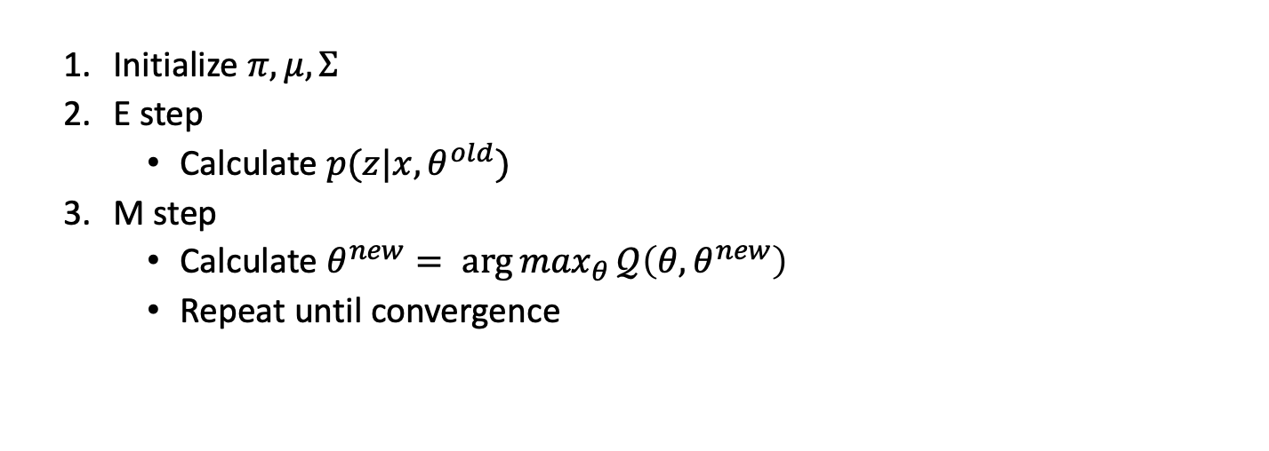
Generalized EM Algorithm
Initialize $π, μ, Σ$
E step
Calculate $p(z|x,θ^{old})$
M step
Calculate $θ^{new}= {\arg{max}}_{θ}𝒬\left(θ, θ^{new}\right)$
Repeat until convergence

Slide 72
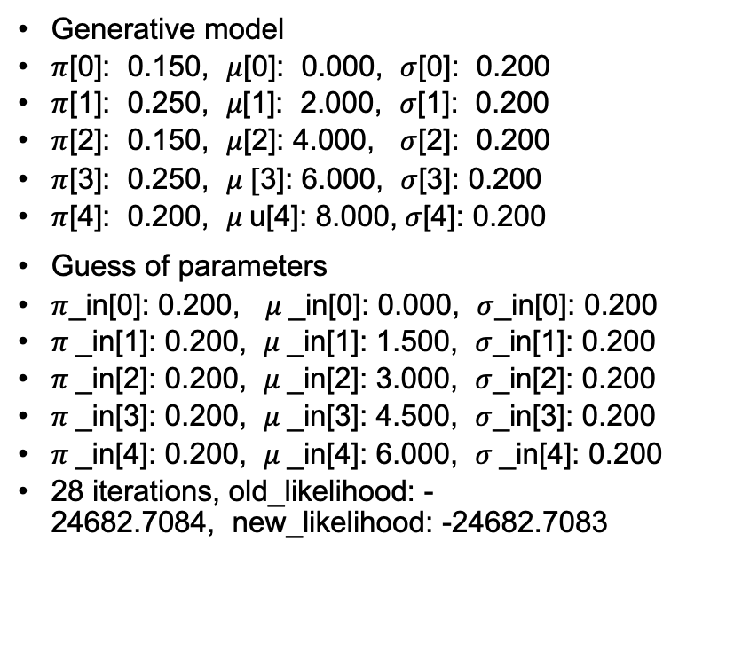
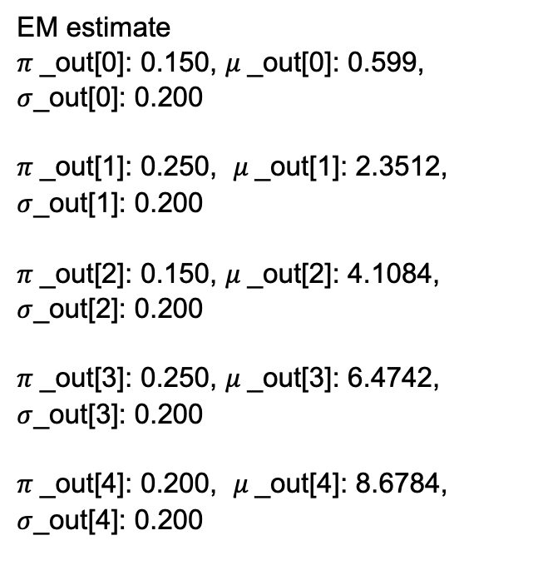
EM example
Generative model
$π$[0]: 0.150, $μ$[0]: 0.000, $σ$[0]: 0.200
$π$[1]: 0.250, 𝜇[1]: 2.000, $σ$[1]: 0.200
$π$[2]: 0.150, $μ$[2]: 4.000, $σ$[2]: 0.200
$π$[3]: 0.250, $μ [$3]: 6.000, $σ$[3]: 0.200
$π$[4]: 0.200, $μ$u[4]: 8.000, $σ$[4]: 0.200
Guess of parameters
$π$_in[0]: 0.200, $μ$_in[0]: 0.000, $σ$_in[0]: 0.200
$π$_in[1]: 0.200, $μ$_in[1]: 1.500, $σ$_in[1]: 0.200
$π$_in[2]: 0.200, $μ$_in[2]: 3.000, $σ$_in[2]: 0.200
$π$_in[3]: 0.200, $μ$_in[3]: 4.500, $σ$_in[3]: 0.200
$π$_in[4]: 0.200, $μ$_in[4]: 6.000, $σ$_in[4]: 0.200
28 iterations, old_likelihood: -24682.7084, new_likelihood: -24682.7083
EM estimate
$π$_out[0]: 0.150, $μ$_out[0]: 0.599,
$σ$_out[0]: 0.200
$π$_out[1]: 0.250, $μ$_out[1]: 2.3512,
$σ$_out[1]: 0.200
$π$_out[2]: 0.150, $μ$_out[2]: 4.1084,
$σ$_out[2]: 0.200
$π$_out[3]: 0.250, $μ$_out[3]: 6.4742,
$σ$_out[3]: 0.200
$π$_out[4]: 0.200, $μ$_out[4]: 8.6784,
$σ$_out[4]: 0.200

Slide 73
Markov chains
A Markov chain is a stochastic process involving a sequence of states and transitions from state to state where transitions to next state depend only on current state. Simplest model of dependent time sequences
Parameters
states S={1,2,…, s}
initial probabilities 𝜋(i), i∈S
transition probabilities p_{ij}= probability state i transitions to state j, i, j ∈S
EM also solves the maximum likelihood estimation of Markov parameters.

Slide 74
Data mining and analysis, part 8, neural nets
Neural Networks
Backpropagation
Deep learning

Slide 75
Neural networks
f(x) outputs house price. For NN simplest is f(x)= max(a^{T}x+b,0)
Input to NN are features x₁, x₂, …, x_{n,} outputs are called activations, a₁, …, a_{n}. For single neuron, z = W^{T}x + b, activation function is a = g_{sigmoid}(z) or ReLu(z)= max(z, 0) or tanh(z).
Notation:
Training set (x(k), y(k)), i= 1, 2,…, m, L layer neural net.
Input to layer l is x₁^{[l]}, …, x_{n}^{[l]}. z^{[l]}_{i} = W^{[l]T} x_{i} + b^{[l]}_{i}. Activation at layer l is a^{[l]}_{i} = g(z^{[l]}_{i}).
z^{[1]}₁ = W^{[1]T}₁x + b^{[1]}₁, a^{[1]}₁ = g(z^{[1]}₁)
z^{[1]}₂ = W^{[1]T}₂x + b^{[1]}₂, a^{[1]}₂ = g(z^{[1]}₂)
z^{[1]}₃ = W^{[1]T}₃x + b^{[1]}₃, a^{[1]}₃ = g(z^{[1]}₃)
z^{[2]}₁ = W^{[2]T}₁a^{[1]} + b^{[2]}₁, a^{[2]}₁ = g(z^{[2]}₁)
For N layers, we put W = matrix of the W^{[l]}. Same for b, a and z.
size
family size
# rooms
walkable
price
zip
school
wealth
Layer 1
Layer 2
From Ng

Slide 76
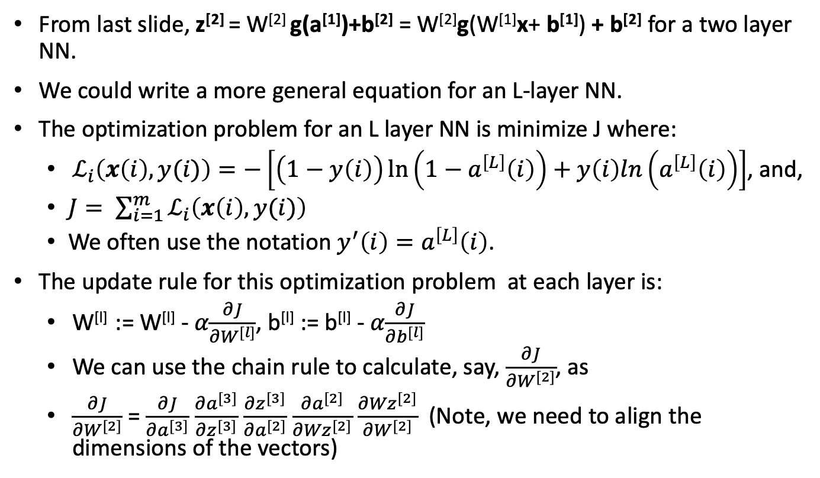
Neural networks
From last slide, z^{[2]} = W^{[2]} g(a^{[1]})+b^{[2]} = W^{[2]}g(W^{[1]}x+ b^{[1]}) + b^{[2]} for a two layer NN.
We could write a more general equation for an L-layer NN.
The optimization problem for an L layer NN is minimize J where:
$ℒ_{i}\left(x\left(i\right), y(i)\right)=−\left[\left(1−y\left(i\right)\right)\ln\left(1−a^{\left[L\right]}\left(i\right)\right)+y\left(i\right)ln\left(a^{\left[L\right]}\left(i\right)\right)\right]$, and,
$J= \sum_{i=1}^{m}{ℒ_{i}\left(x\left(i\right), y(i)\right)}$
We often use the notation $y^{′}\left(i\right)=a^{\left[L\right]}\left(i\right)$.
The update rule for this optimization problem at each layer is:
W^{[l]} := W^{[l]} - 𝛼$\frac{∂J}{∂W^{[l]}}$, b^{[l]} := b^{[l]} - 𝛼$\frac{∂J}{∂b^{[l]}}$
We can use the chain rule to calculate, say, $\frac{∂J}{∂W^{[2]}}$, as
$\frac{∂J}{∂W^{[2]}}$ = $\frac{∂J}{∂a^{[3]}}$ $\frac{∂a^{[3]}}{∂z^{[3]}}$ $\frac{∂z^{[3]}}{∂a^{[2]}}$ $\frac{∂a^{[2]}}{∂{Wz}^{[2]}}$ $\frac{∂{Wz}^{[2]}}{∂W^{[2]}}$ (Note, we need to align the dimensions of the vectors)

Slide 77
Neural networks
As we can see, given a multi-layer NN, a modest number of input features and significant data the computational size of the NN optimization problem is enormous compared to other problems we’ve seen. However, conceptually, the optimization employs the same stochastic gradient descent we’ve seen several times.
Procedure
Initialize W^{[1]}, b^{[1]}, W^{[2]}, b^{[2]}, … to small non-zero random values
Apply Update rules
Repeat until convergence

Slide 78
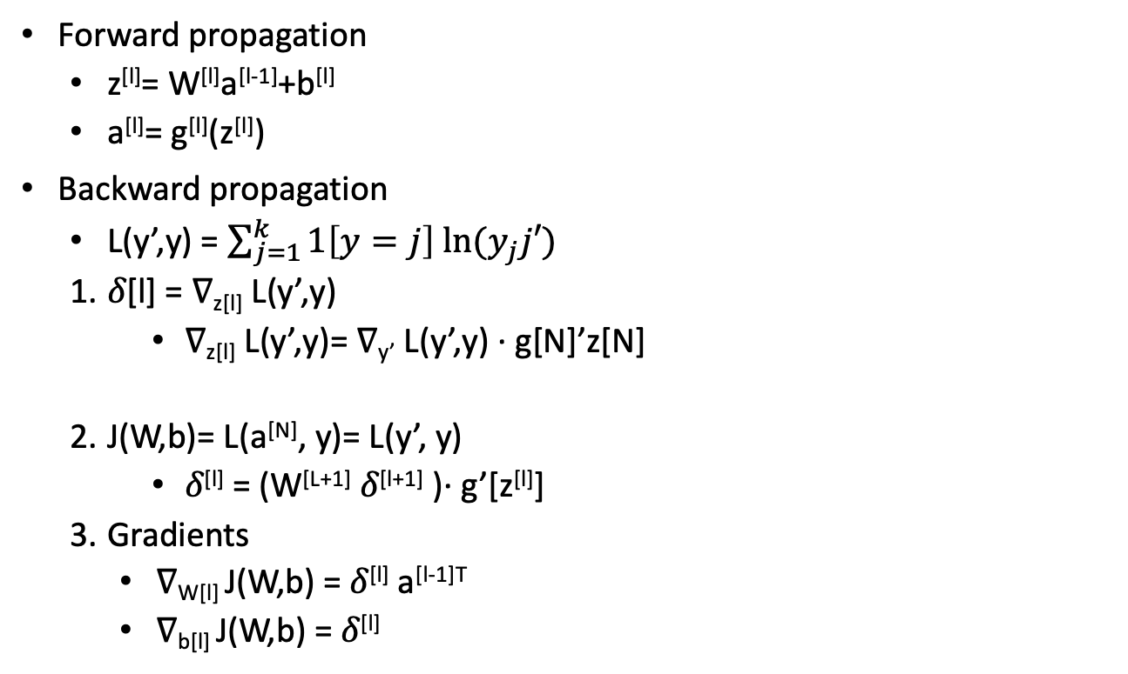
Propagation
Forward propagation
z^{[l]}= W^{[l]}a^{[l-1]}+b^{[l]}
a^{[l]}= g^{[l]}(z^{[l]})
Backward propagation
L(y’,y) = $\sum_{j=1}^{k}{1\left[y=j\right] ln⁡(y_{j}j′)}$
𝛿[l] = ∇_{z[l]} L(y’,y)
∇_{z[l]} L(y’,y)= ∇_{y’} L(y’,y) ∙ g[N]’z[N]
J(W,b)= L(a^{[N]}, y)= L(y’, y)
𝛿^{[l]} = (W^{[L+1]} 𝛿^{[l+1]} )∙ g’[z^{[l]}]
Gradients
∇_{W[l]} J(W,b) = 𝛿^{[l]} a^{[l-1]T}
∇_{b[l]} J(W,b) = 𝛿^{[l]}

Slide 79
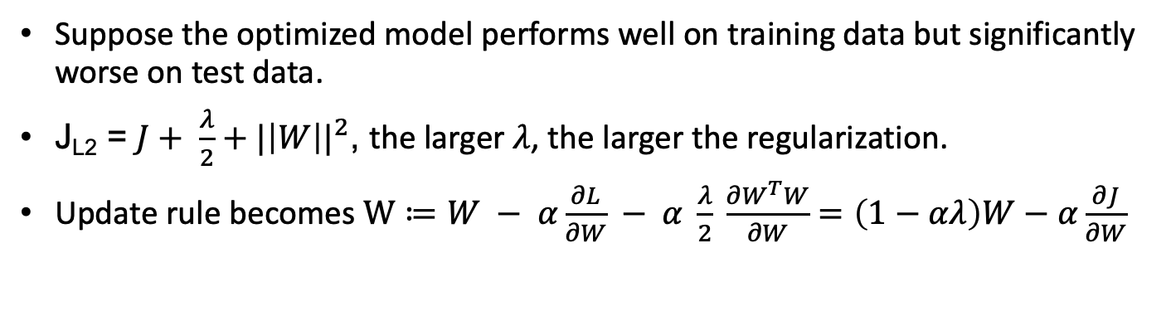
Regularization
Suppose the optimized model performs well on training data but significantly worse on test data.
J_{L2} = $J+ \frac{λ}{2}+{|\left|W\right||}^{2}$, the larger 𝜆, the larger the regularization.
Update rule becomes $W≔W − α\frac{∂L}{∂W} − α \frac{λ}{2} \frac{∂W^{T}W}{∂W}=\left(1−αλ\right)W−α\frac{∂J}{∂W}$

Slide 80
Deep Learning
Multi-layer neural networks
Must pick input features, number of layers, activation function, NN topology
A multi-layer NN learns an “arbitrary” non-linear function
How many layers?
Advantages
Better asymptotic learning with large data
Disadvantages
Huge computational and training data requirements

Slide 81
Neural networks: Small example
Todo

Slide 82
Other neural network topology
Feed forward
Convolutional (feed forward)
Recurrent
Todo

Slide 83
Data mining and analysis, part 9 , ensemble methods
Measuring how good features are
Decision Trees
Principal Component analysis
Ensemble learning: Adaboost

Slide 84
Measuring how good features are
The first method is simple but expensive:
Collect all the features you can and collect labelled data.
Divide the labelled set into two subsets: a training set to train your selected classified and a test set.
Train your classifier on every subset of the features and evaluate each of them on the test set.
Pick the subset that does best.
There are heuristics you can use. One is to choose features with maximally independent information.
For example, in our ongoing housing example, “number of bedrooms” and “size of house” are very strongly correlated so discarding one is probably a good idea.
You can estimate cross feature information using entropy: I(X|Y)= H(X|Y) – H(Y).

Slide 85
Decision trees
The silly diagram on the right illustrates a decision tree with binary features determining branches. (Apologies for the inaccurate and elitist underlying model.)
Building a tree requires:
Determining features (They do not have to be binary)
Knowing what outcomes to predict
Determining branching criteria
Branching criteria is often determined by “predictive power” of decision and discrimination. We want branches that are highly predictive and which efficiently “split” the incoming data equally to shorten the tree. Entropy is a good measure.
Physics major
Yes
No
A or B in Calculus
Becomes lawyer
Yes
No
A or B in Physics I
Becomes economist
No
Yes
PhD from Cambridge
Becomes doctor
Yes
No
Wins Nobel Prize
Joins Intel

Slide 86
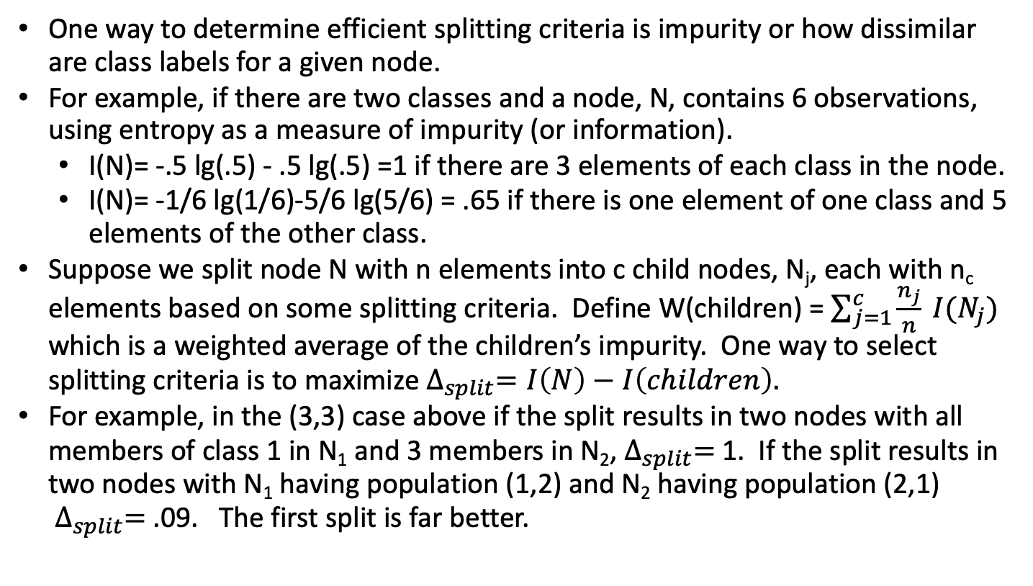
Decision trees
One way to determine efficient splitting criteria is impurity or how dissimilar are class labels for a given node.
For example, if there are two classes and a node, N, contains 6 observations, using entropy as a measure of impurity (or information).
I(N)= -.5 lg(.5) - .5 lg(.5) =1 if there are 3 elements of each class in the node.
I(N)= -1/6 lg(1/6)-5/6 lg(5/6) = .65 if there is one element of one class and 5 elements of the other class.
Suppose we split node N with n elements into c child nodes, N_{j}, each with n_{c} elements based on some splitting criteria. Define W(children) = $\sum_{j=1}^{c}{\frac{n_{j}}{n}} I(N_{j})$ which is a weighted average of the children’s impurity. One way to select splitting criteria is to maximize $∆_{split}=I\left(N\right)−I\left(children\right).$
For example, in the (3,3) case above if the split results in two nodes with all members of class 1 in N₁ and 3 members in N₂,${ ∆}_{split}=$ 1. If the split results in two nodes with N₁ having population (1,2) and N₂ having population (2,1) ${ ∆}_{split}=$ .09. The first split is far better.

Slide 87

Principal component analysis
Orthogonal projection of data to lower dimension
Maximize variance of projected data
Minimize mean squared distance between data points and projections
First principal component is largest eigenvector of covariance. Same as maximizing binary form subject to ||w|| = 1.
Let $X=\left(x_{i} −μ_{i}\right)$. M = XX^{T}.
Second principal component is orthogonal to first and second eigenvectors
Credit: Alina Opera

Slide 88
PCA example
PCA data
1.0000 1.0000 1.0000
2.0000 1.0000 0.5000
3.0000 1.0000 0.3333
4.0000 1.0000 0.2500
5.0000 1.0000 0.2000
6.0000 1.0000 0.1667
7.0000 1.0000 0.1429
8.0000 1.0000 0.1250
9.0000 1.0000 0.1111
10.0000 1.0000 0.1000
Direction with greatest variation: 0.9993 0.0000 -0.0373

Slide 89
Ensemble learning
Given classifiers h₁, …, h_{L}, construct classifier H(x) that combines them.
Requires diversity: different classifiers should make different mistakes
Adaboost (adaptive bosting) is an example.
Credit: Alina Opera

Slide 90

AdaBoost
Turn T base learners into high performance classifier by weighting them.
Input: Training data, (x(i), y(i)), I = 1,…,m
Initialize: $w_{1}=(\frac{1}{m}, \frac{1}{m}, …, \frac{1}{m})$
for(t=1 to T) {
Train h_{t} on training data with weight w_{t}.
Compute $ε_{t}= \sum_{i:y\left(i\right)≠h_{t}(x\left(i\right))}{w_{t,i}}$, choose $β_{t}= \frac{1}{2}ln⁡(\frac{1−ε_{t}}{ε_{t}})$
Update $w_{t+1,i}=w_{t,i }exp⁡(−β_{t} y(i)h_{t}(x\left(i\right))$
Normalize${ w}_{t+1,i}= \frac{w_{t+1,i}}{\sum_{j=1}^{m}{w_{t+1,j}}}$
}
Return $H\left(x\right)=sign(\sum_{t=1}^{T}{β_{t}h_{t}(x)})$
Credit: Alina Opera

Slide 91
AdaBoost example
Param 1 | Param 2 | Decision
2 | 3 | true
2.1 | 2 | true
4.5 | 6 | true
4 | 3.5 | false
3.5 | 1 | false
5 | 7 | true
5 | 3 | false
6 | 5.5 | true
8 | 6 | false
8 | 2 | false
Use logistic regression to determine classifiers based on parameter 1 and parameter 2.
Combine them using AdaBoost.
From: Sefik Ilkin Serengil

Slide 92
Algorithm comparison
Algorithm | Problem | Interpretable | Explainable | Accuracy | Training speed | Prediction speed
kNN | either | yes | yes | low | fast | Depends
Linear regression | regression | yes | yes | low | fast | fast
Logistic regression | classification | sometimes | sometimes | low | fast | fast
Naïve Bayes | classification | often | sometimes | low | fast | fast
Decision trees | either | often | sometimes | low | fast | fast
Random Forest | either | A little | no | high | slow | moderate
AdaBoost | either | A little | no | high | slow | fast
Neural Networks | either | no | no | high | slow | fast
From Alina Opera

Slide 93
But wait, there’s more
We have not discussed:
How we pick features (At least not in depth)
Generating training data
Confidence measures
Detecting data that has been tampered with
How fast can we learn?
How fast can we predict?

Slide 94
Exercises
Classifying images
Classifying syndromes
Predicting car sales prices
Diffusion
What data would you collect from IoT devices to predict maintenance issues
What can you discover about net revenue from an IoT connected store?
Flight patterns
IFF problems

Slide 95
References
UC, Berkeley, Amplab Tutorials
Andrew Ng, Stanford Machine Learning class notes and videos, cs229. Highly recommended.
Bishop, Pattern recognition and machine learning.
Tan, Steinbach and Kumar, Introduction to Data Mining.
Spiegal, Probability and Statistics.
Alina Opera, Class notes, Northeastern University.
Kevin Murphy, Machine Learning: a Probabilistic Perspective

Slide 96
License
This material is licensed under Apache License, Version 2.0, January 2004. Use, duplication or distribution of this material is subject to this license and any such use, duplication or distribution constitutes consent to license terms.
You can find the full text of the license at: http://www.apache.org/licenses/.

Slide 97
Data analytics
Collection, provenance and data formatting
Probability, randomness, information, distributions and significance
What are we trying to learn?
Features, supervised and unsupervised learning
Regression, similarity, curve fitting and loss functions
Clustering
Bayes theorem, maximum likelihood re-estimation, EM and latent variables
Classification
Naïve Bayes
SVM
Neural networks
Principal Component analysis and the curse of dimensionality
Deep learning

Slide 98
Towards Large Language Models
Incomplete intro (mostly references) to Large Language Models

Slide 99

Variational autoencoders
Used for
Dimensionality reduction
Compression
De-noising
Anomaly detection
Feature extraction
For variational, add noise from normal distribution with parameters $μ, σ$
Reference
https://maurocamaraescudero.netlify.app/post/assessing-a-variational-autoencoder-on-mnist-using-pytorch/
encoder
Latent
variables
decoder
model
model
Minimize
distance
Basic autoencoder

Slide 100

RNN
Language models
text generation
Translation
speech recognition
text summarization
References
https://medium.com/dejunhuang
leewayhertz.com/artificial-intelligence-application-development-company
https://www.analyticsvidhya.com/
100

Slide 101

Generative AI
Reference
https://www.altexsoft.com/blog/generative-ai/
Generative Adversarial Networks
Generator and Discriminator are both NN
Train them both and add noise
Transformers: Attention Is All You Need
Ashish Vaswani, Noam Shazeer, Niki Parmar, Jakob Uszkoreit, Llion Jones, Aidan N. Gomez, Lukasz Kaiser, Illia Polosukhin

Slide 102

Transformers

Slide 103
Papers
Ashish Vaswani et al, Attention Is All You Need (Archiv)
Yang et all, XLNet: Generalized Autoregressive Pretraining for Language Understanding (Archiv)
Zhu, Label Propagation
Lepkhin, G-shard (Archiv)
Kingma, Autoencoding Variational Bayes
Devlin et al, BERT

Slide 104

Attention and Transformers
$θ$ – parameters
w – word
$v_{w}∈ ℝ^{d}$ embedding in real vector space, $d$ is dictionary size
$S_{c}\left(u,v\right)= \frac{u^{T}v}{\left|\left|u\right|\right|\left|v\right||}=\cos\left(α\right)$
Intuition: $v_{Paris}−v_{France}+v_{Italy}=v_{Rome}$
$w→v_{w}$ is word embedding (word2vec)
Skip gram model: $J\left(θ\right)=−\frac{1}{T}\sum_{t=1}^{T}{\lg\left(P\left(w_{t+j} | w_{t}\right)\right)}$. Minimize
For $v ∈ℝ^{k}$ , ${Softmax\left(\vec{v}\right)}_{j}=\frac{exp⁡(v_{j})}{\sum_{k}{exp⁡(v_{k})}}$
$J\left(θ\right)=−\frac{1}{T}\sum_{t=1}^{T}{[\sum_{|j|<c, j≠0}{P\left(w_{t+j} | w_{t}\right)}]}$
$P\left(w_{t+j} | w_{t}\right)= \frac{exp⁡({v_{w_{t+j}}}^{T}∙v_{w_{t})}}{\sum_{w}{exp⁡({v_{w}}^{T}∙v_{w})}}$
$k$ is size of vocabulary
From Ike Chaung’s notes

Slide 105

Attention
$W^{T}=(v_{w_{1}},v_{w_{2}}, …,v_{w_{k}})$
Keys: $κ$
Values: $ν(κ)$
Query: $q$
Want $P(κ|q)$
$\overline{κ}∈ℝ^{d_{k}×n_{k}}.$ $d_{k}$ is size of vocabulary, $n_{k}$ is number of keys
$W∈ℝ^{d_{k}×d}$ is encoder.
$K=W^{T}\overline{κ}$, $K∈ℝ^{d×n_{k}}$
$Q=W^{T}q$, $q∈ℝ^{n_{k}×1}$
$P\left(κ | q\right)=K^{T}Q$ , $K^{T}Q∈ℝ^{n_{k}×d}$
a$ttention\left(q,κ,v\right)=\sum_{κ}{P\left(κ | q\right)v\left(κ\right)={softmax}_{κ}(K^{T}Q v(κ))}$
Seq2seq RNN
From Ike Chaung’s notes

Slide 106

Transformers
Input, $x$
$κ={(W^{(κ)})}^{T_{x}}$
$v={(W^{(v)})}^{T_{x}}$
$q={(W^{(q)})}^{T_{x}}$
Transformer is map $f_{θ}: ℝ^{d×n}→ℝ^{d×n}$, $x∈ℝ^{d×n}$
$Q^{(h)}\left(x^{\left(i\right)}\right)= {W_{h,q}}^{T}x^{(i)}$
$K^{(h)}\left(x^{\left(i\right)}\right)= {W_{h,k}}^{T}x^{(i)}$
$V^{(h)}\left(x^{\left(i\right)}\right)= {W_{h,v}}^{T}x^{(i)}$
$h$ is index over transformers
${α_{ij}}^{(h)}$ are the attention weights
${α_{ij}}^{(h)}= {softmax}_{j}(\frac{{Q^{(h)}\left(x^{\left(i\right)}\right)}^{T}K^{(h)}\left(x^{\left(i\right)}\right)}{\sqrt{d_{k}}})$
Model parameters are ${W_{h,q}}^{T}x^{(i)}$, ${W_{h,k}}^{T}x^{(i)}$, ${W_{h,v}}^{T}x^{(i)}$, $W_{h}$, $W_{1}$,$W_{2}$, layer embeddings
From Ike Chaung’s notes

